Slide 1






Slide 2
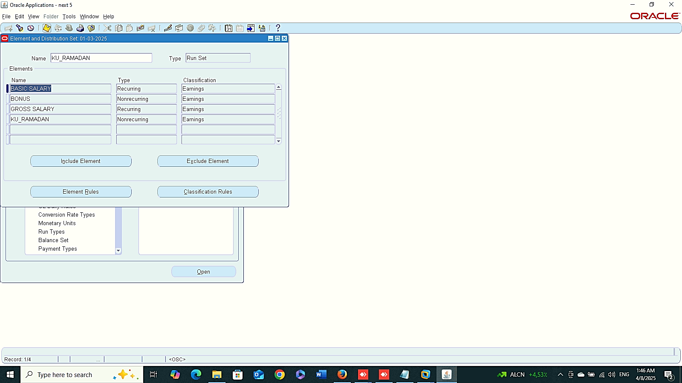
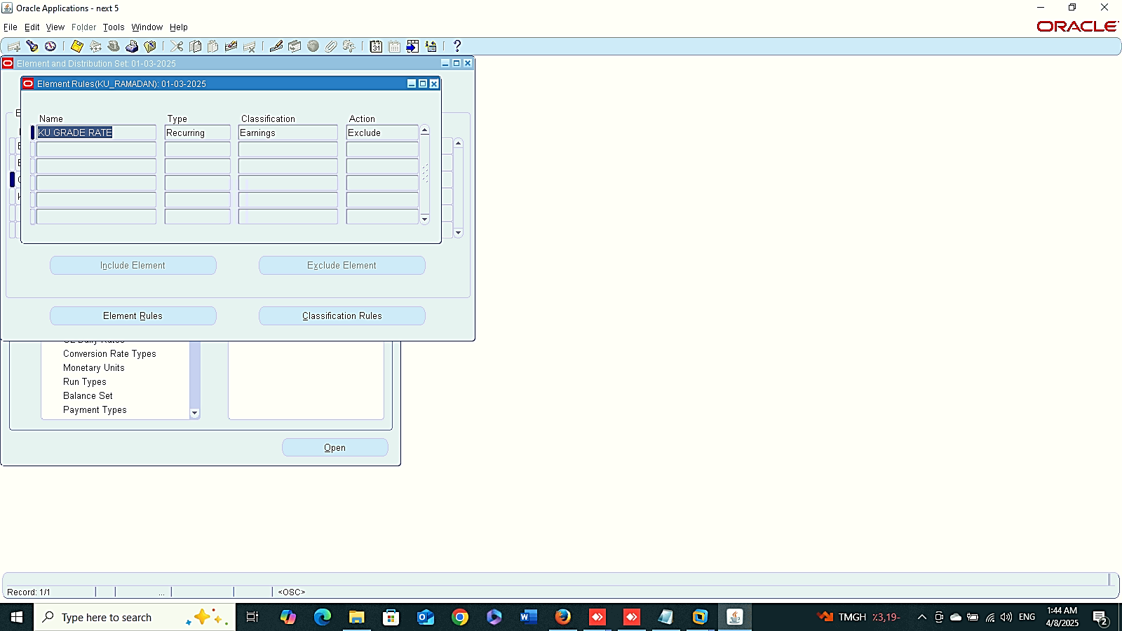
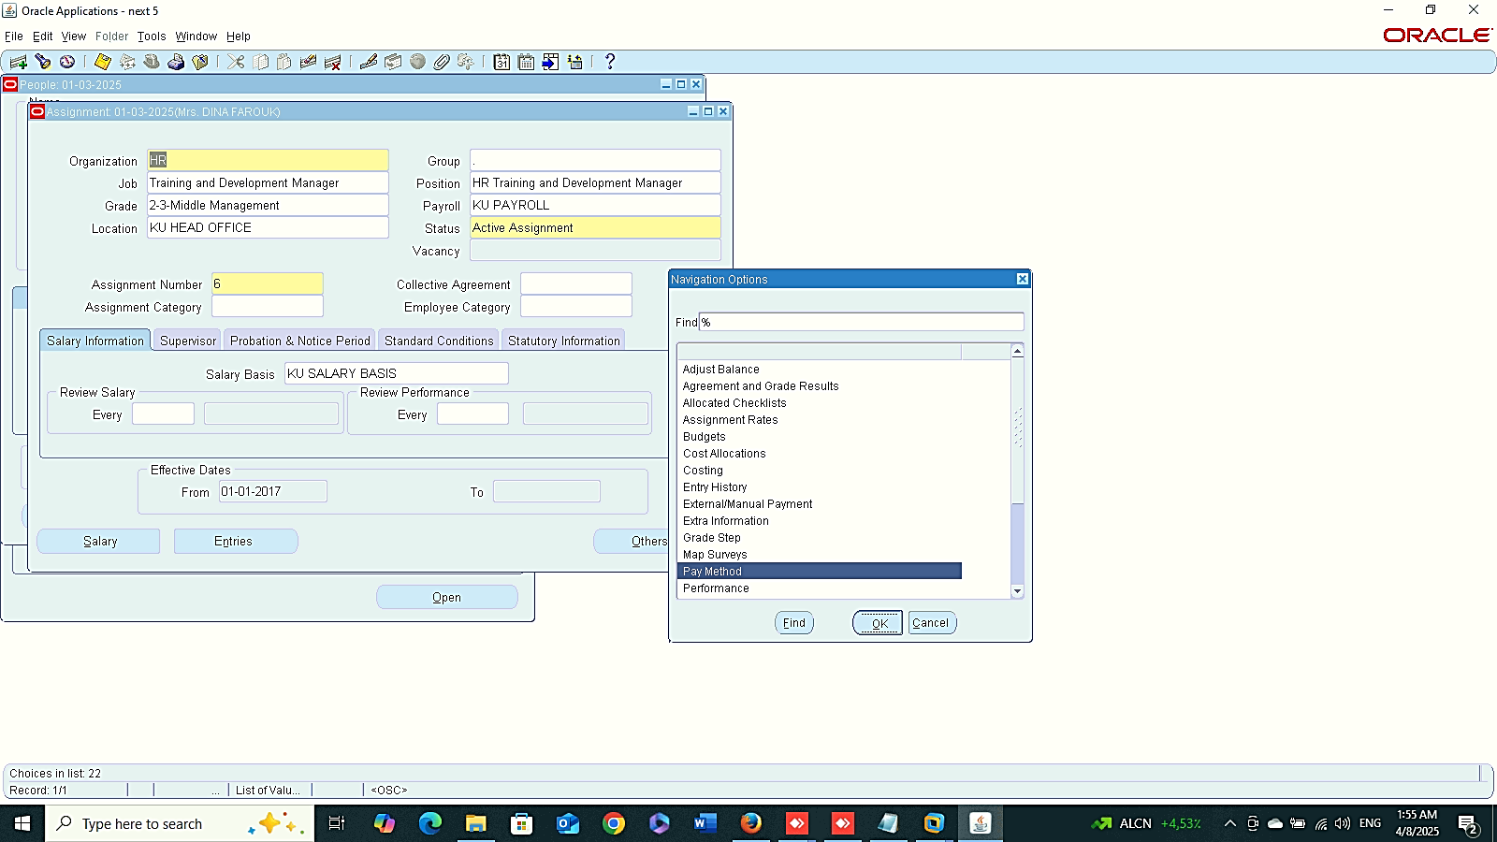
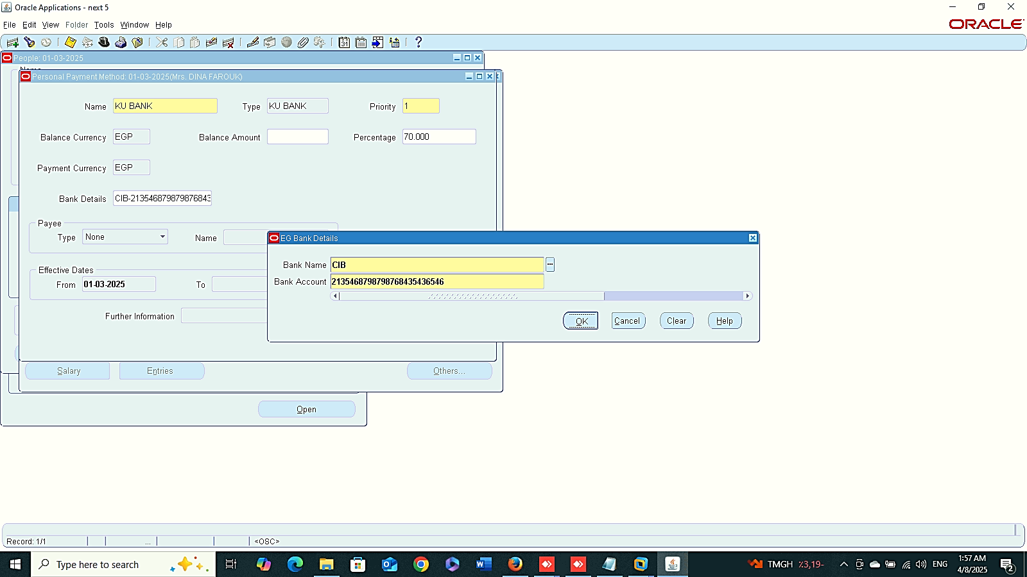
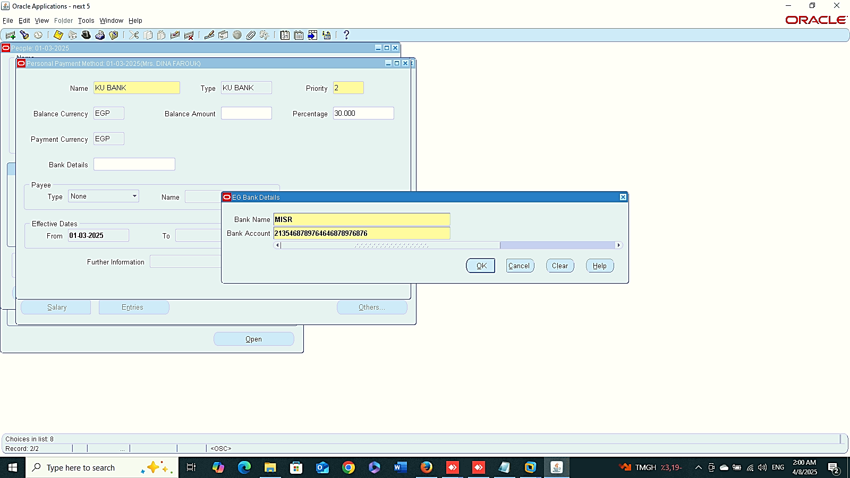
Exclude Element
Element Rules
Finance Management (Payroll)
Exclude Element
Element Rules
Run Payroll :
1- Payment Method
Global HRMS MANAGER > PEOPLE > ENTER AND MAINTAIN > FIND > ASSIGMENT > OTHER > PAYMENT METHOD
Payment Method

Slide 3
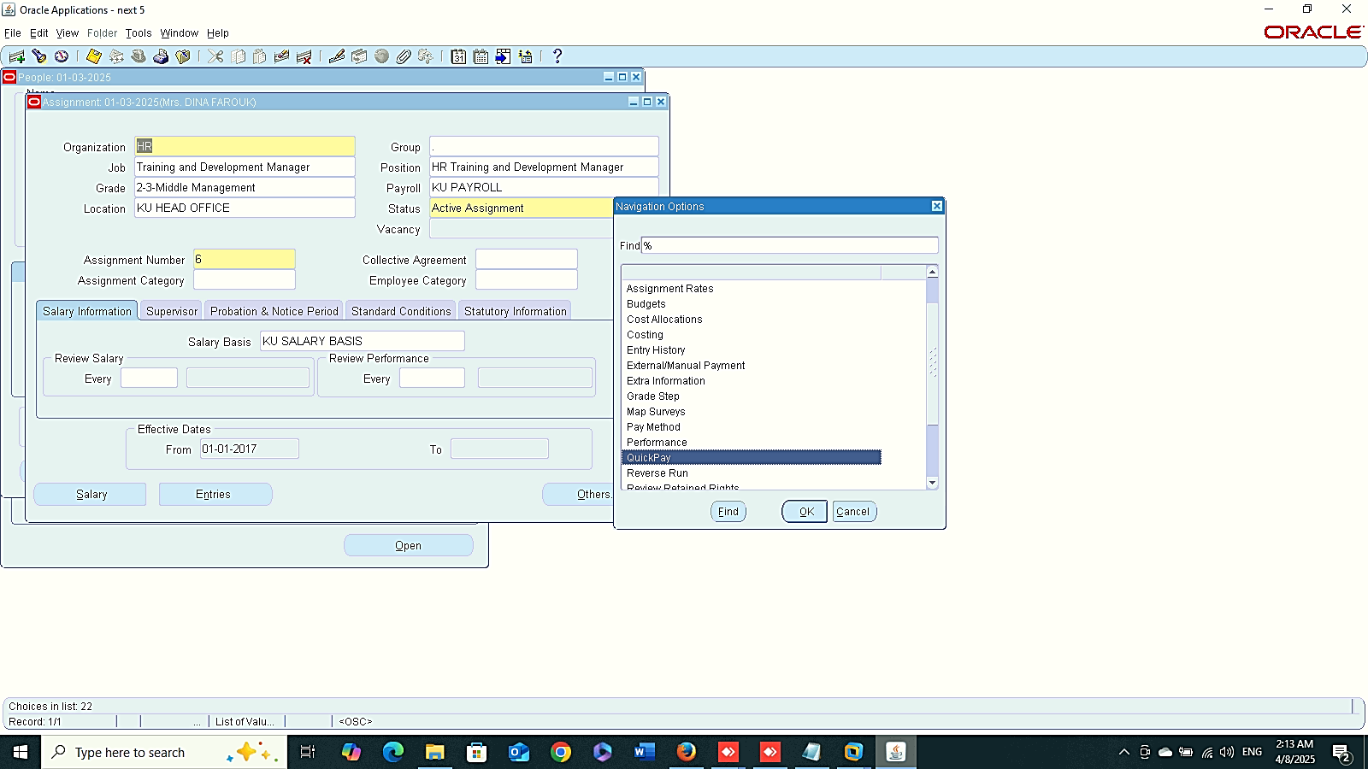
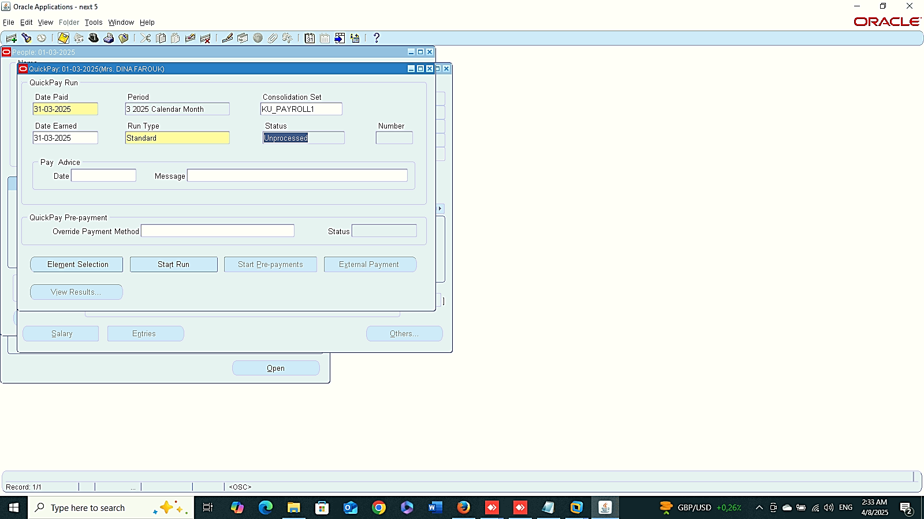

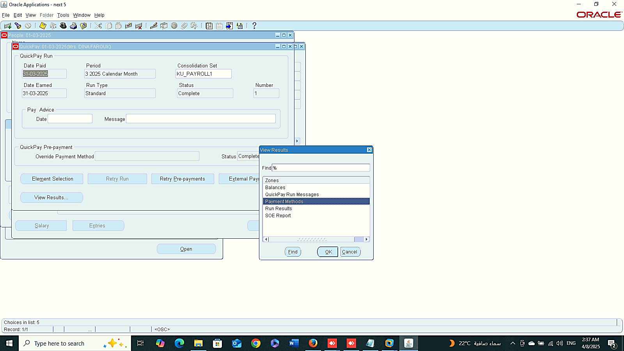
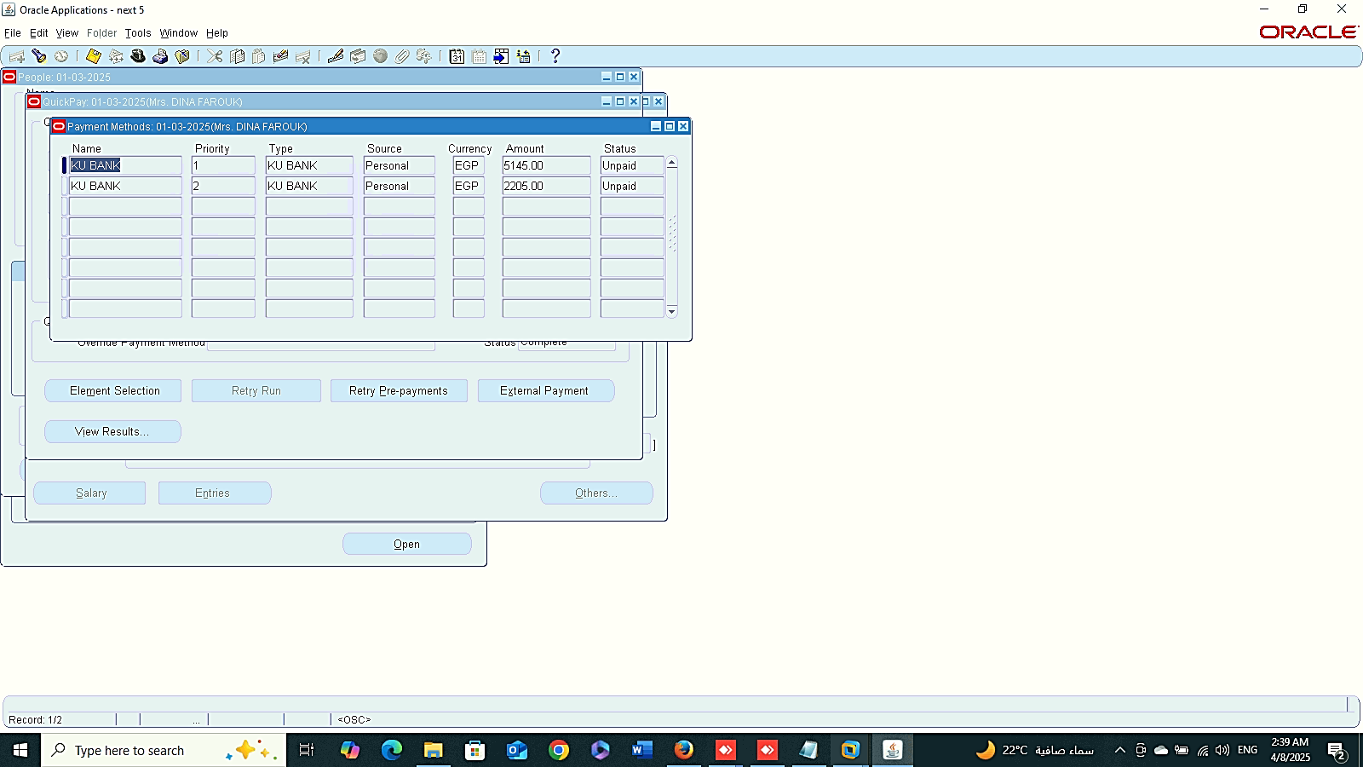
Quick Pay
2
1
Finance Management (Payroll)
Run Payroll :
2- Quick Pay
Prepayment:
View Results
(Payment Method)
3
Repayment

Slide 4
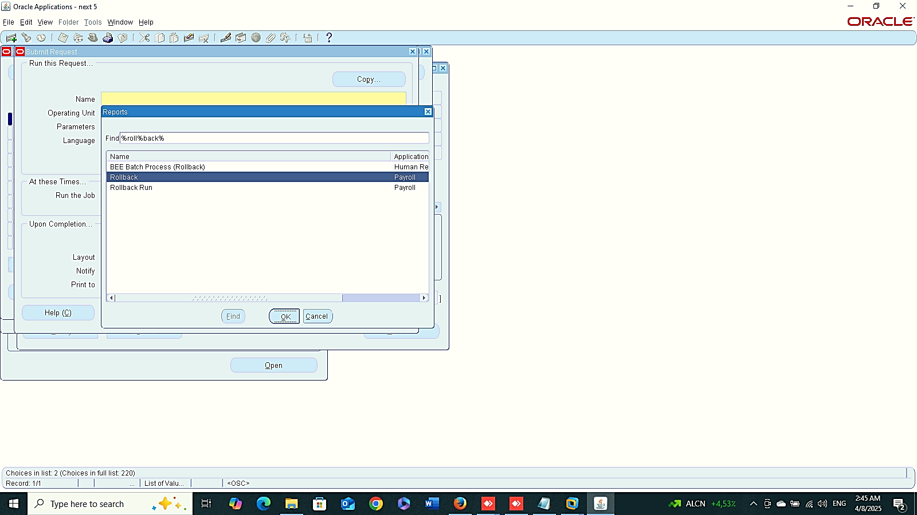
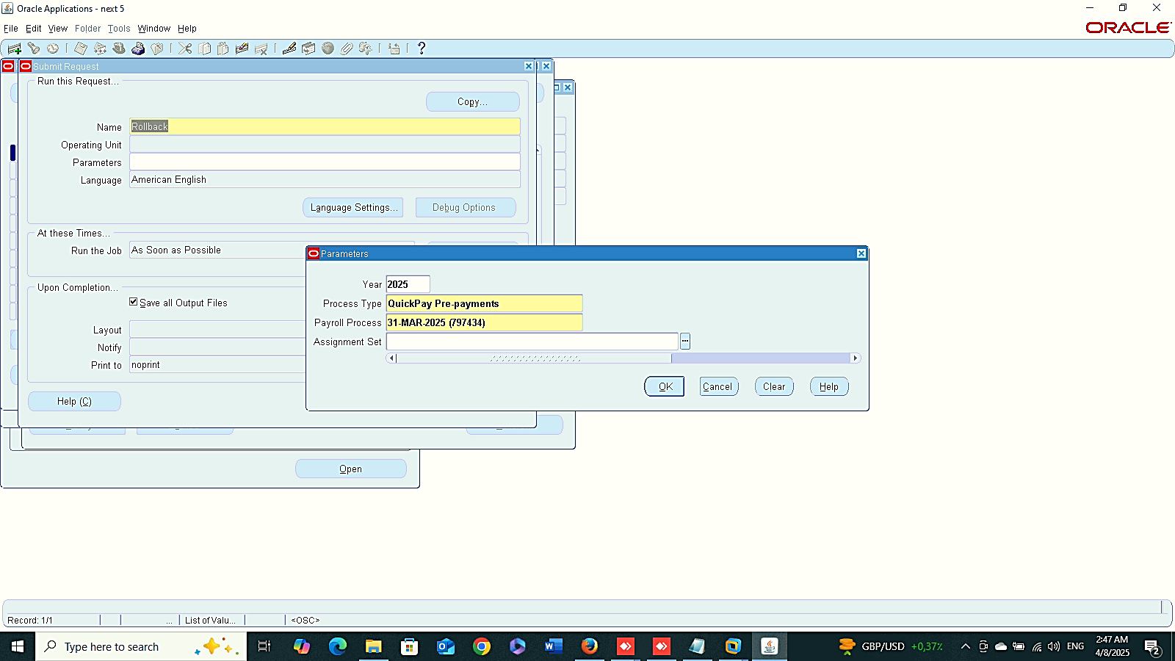
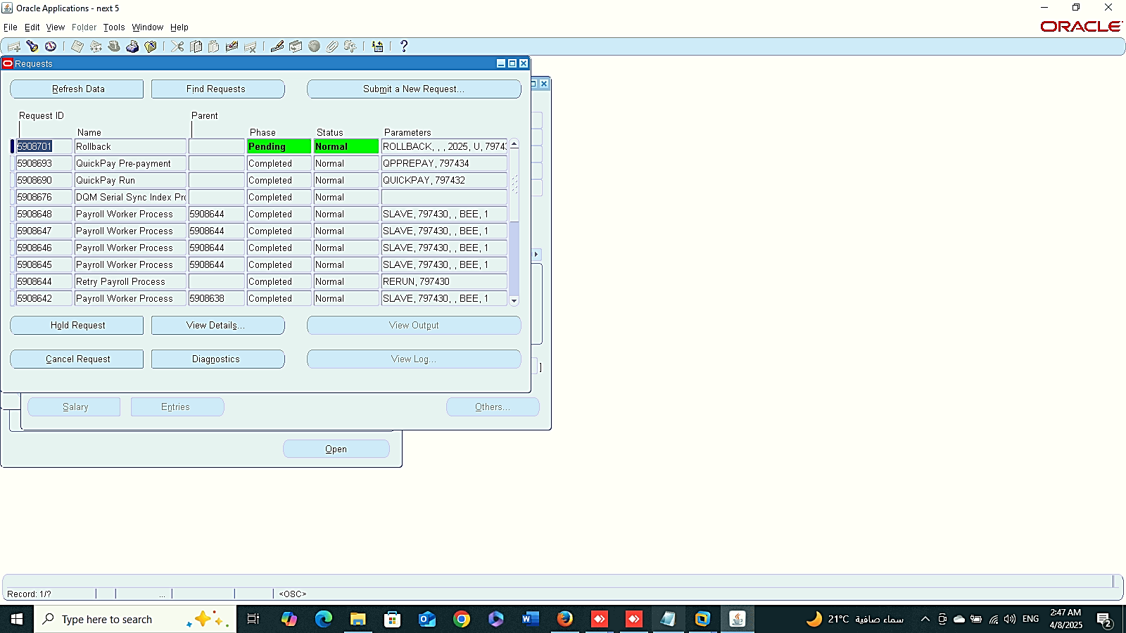
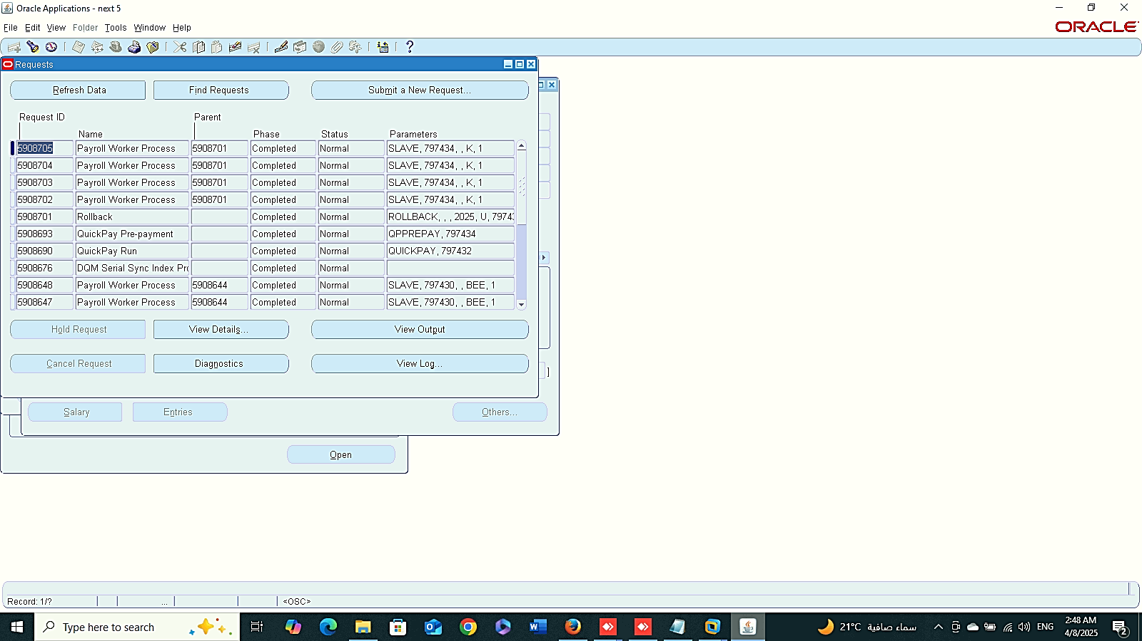
Requests
Quick Pre-Payments
1
Finance Management (Payroll)
Delete Payment Method:
1- Requests
Global HRMS MANAGER > VIEW > REQUESTS > SUBMIT A NEW REQUEST
Quick Pay Prepayment
2
3

Slide 5
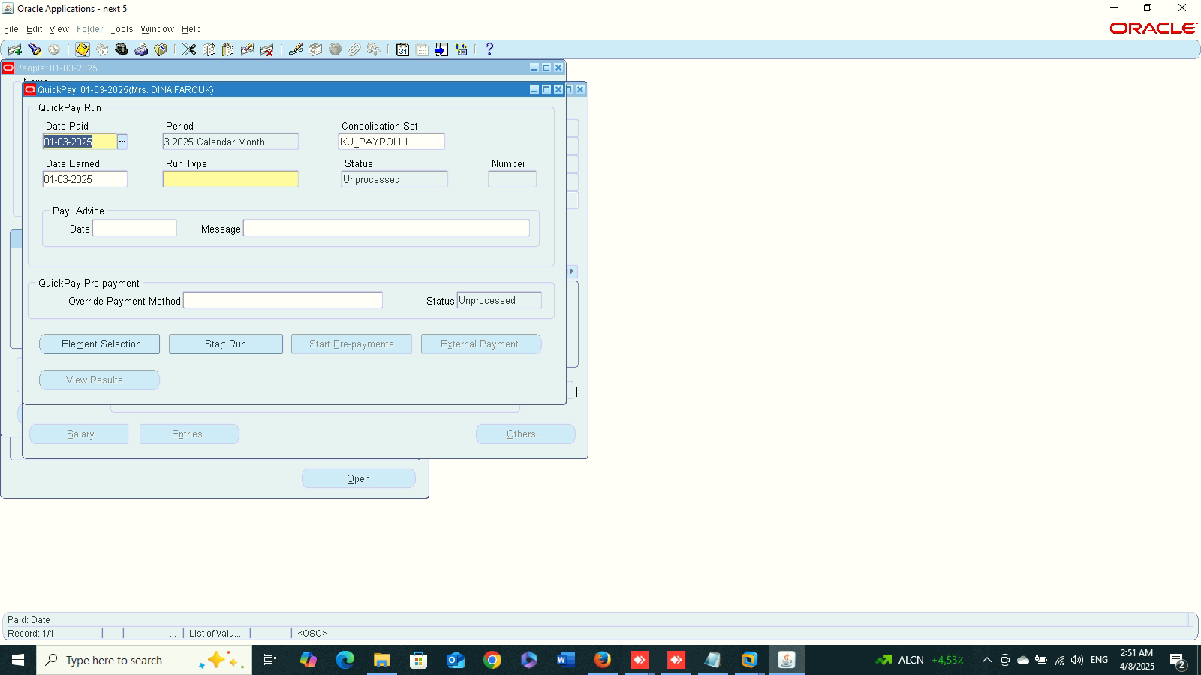
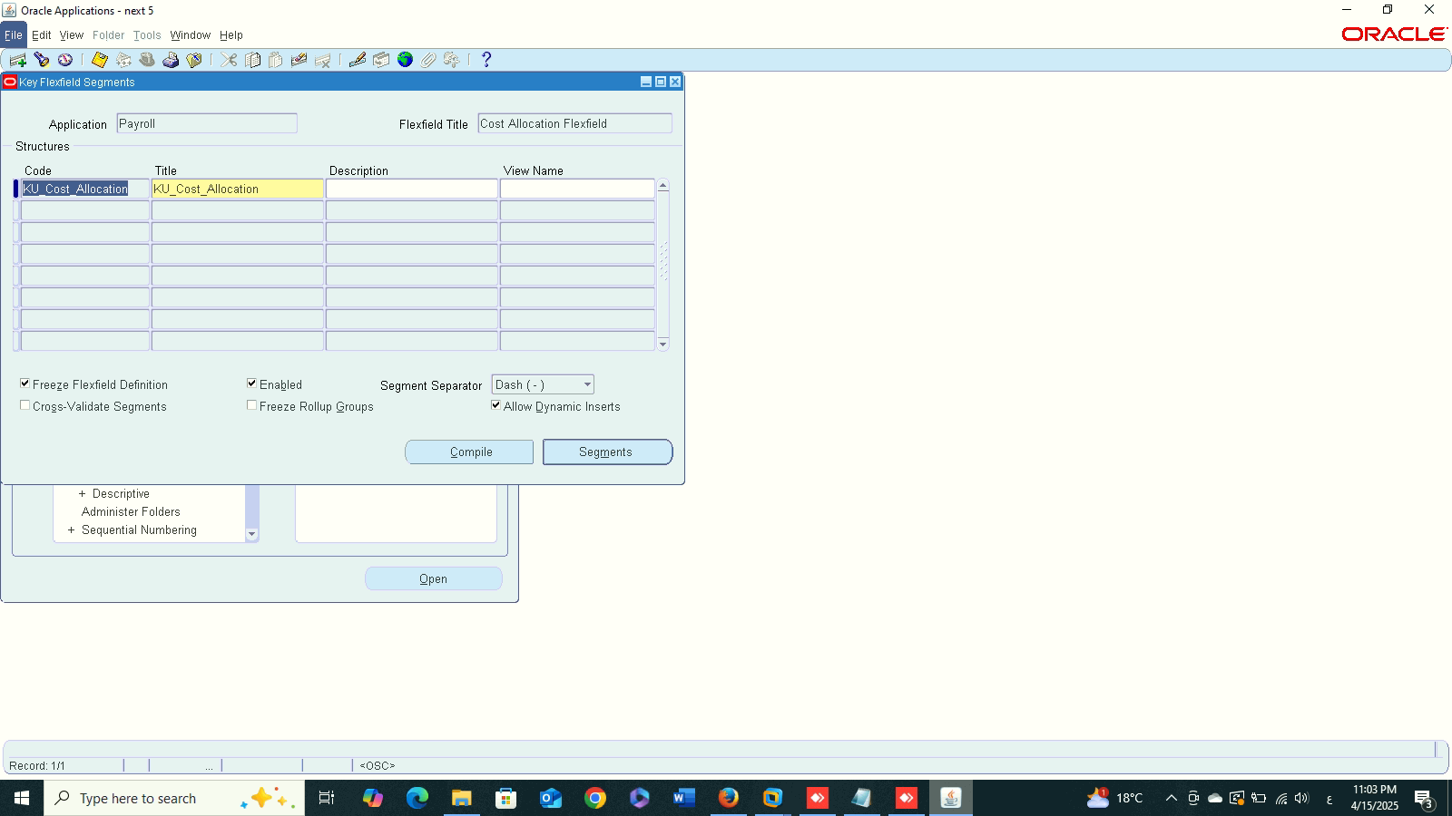
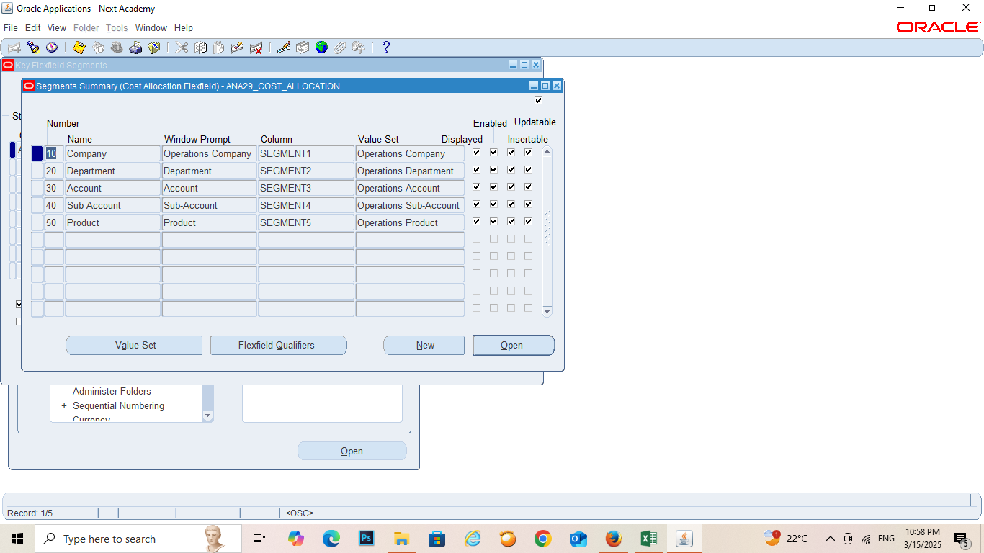
Delete
Cost Allocation
1
Finance Management (Payroll)
Delete
Cost :
1- Cost Allocation
SYSTEM ADMINISTRATOR > APPLICATION > FLEX_FIELD > KEY > SEGMENTS
Application : Payroll
Flex-field Title: Cost Allocation
2

Slide 6
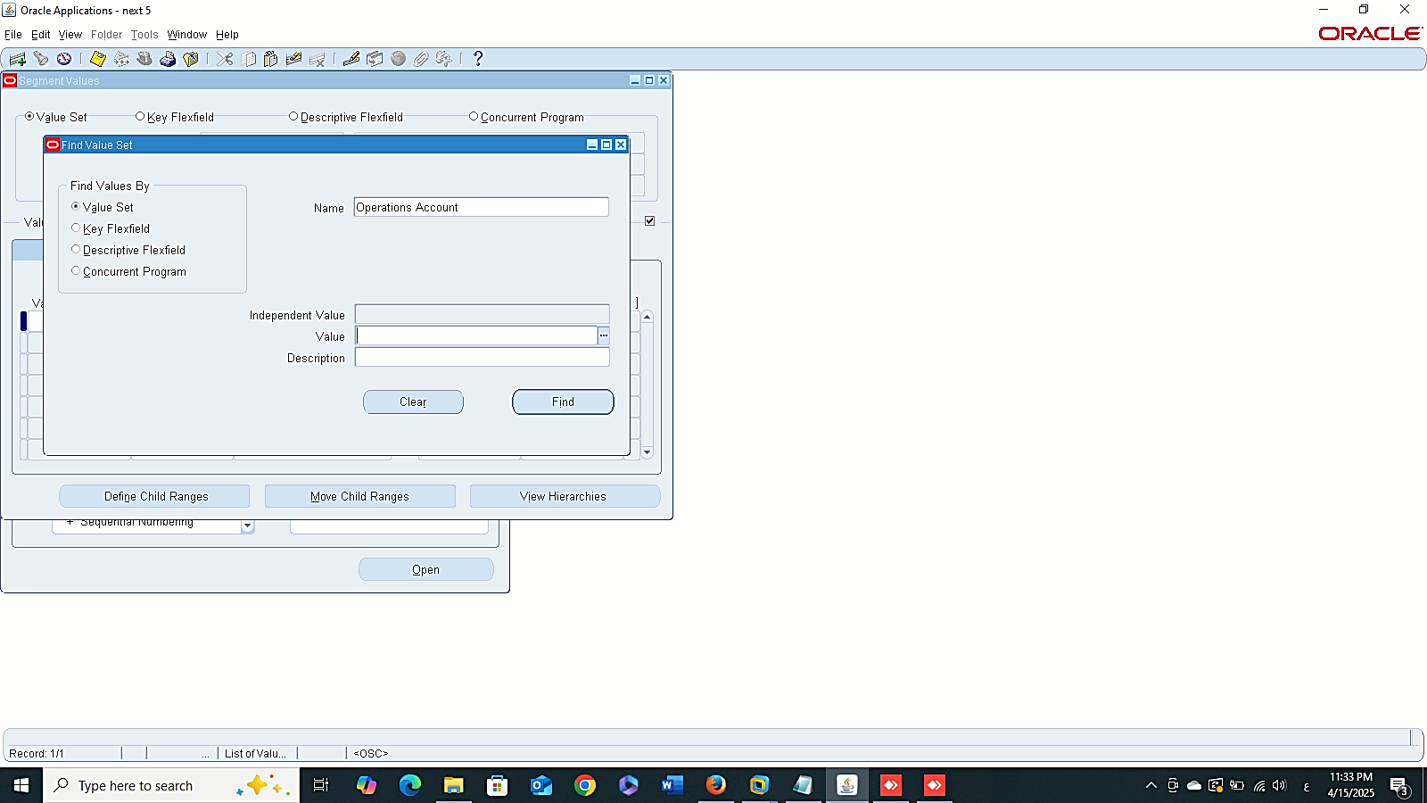
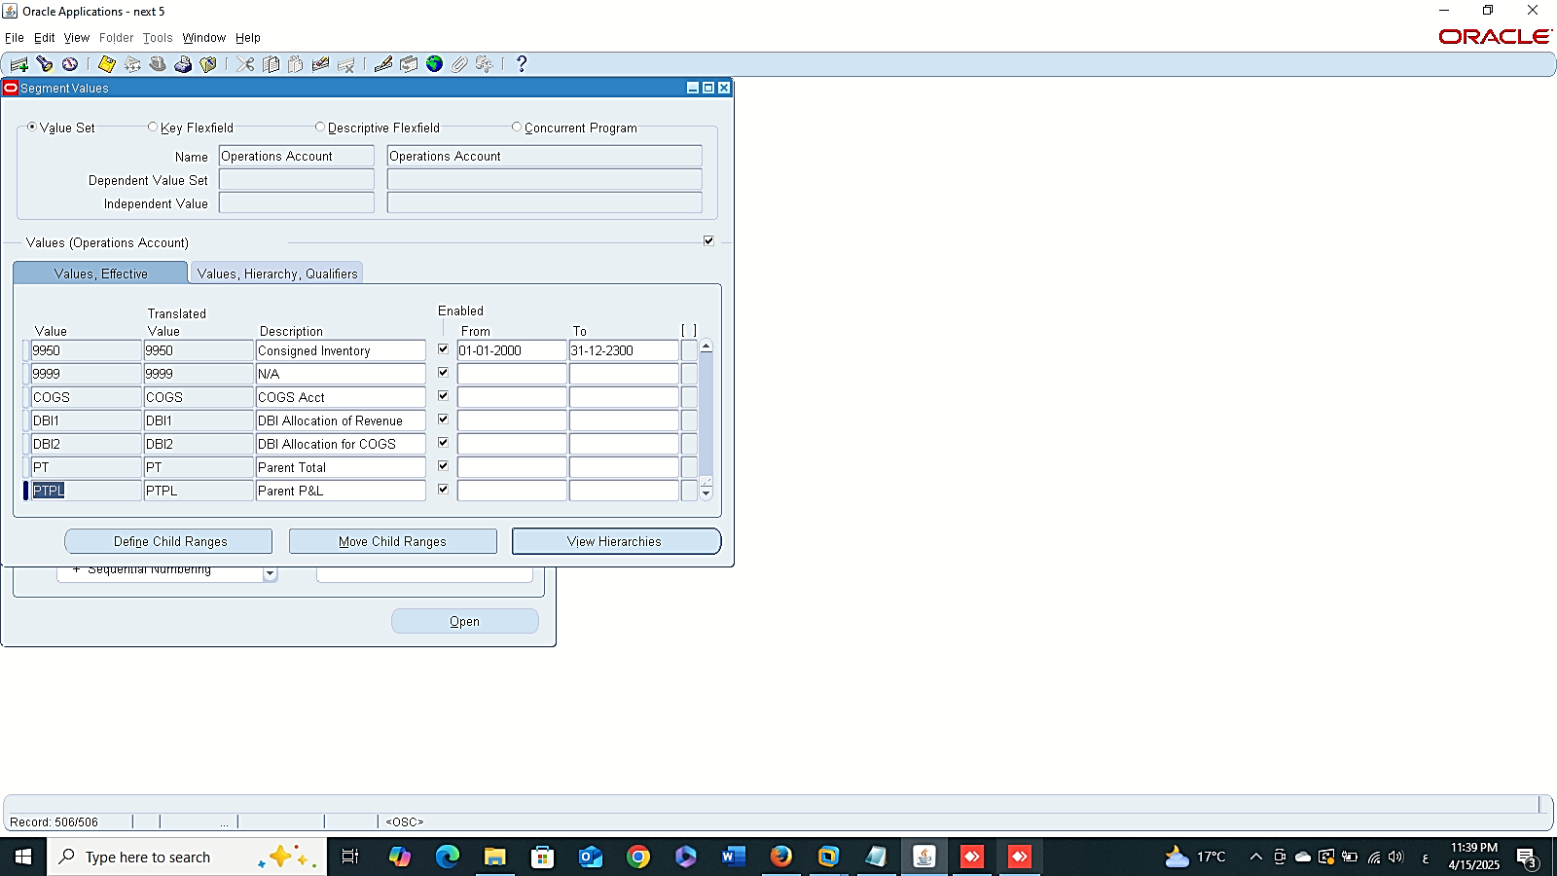
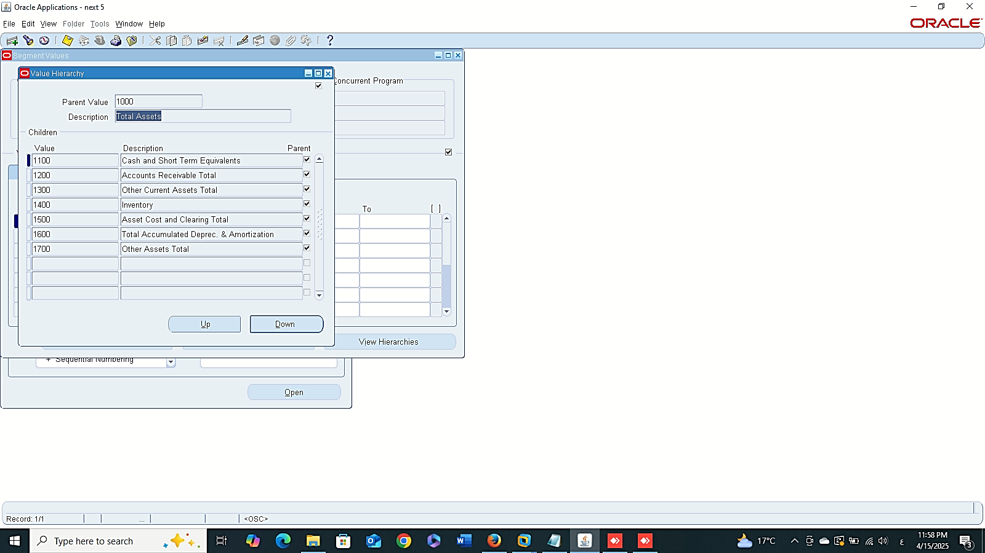
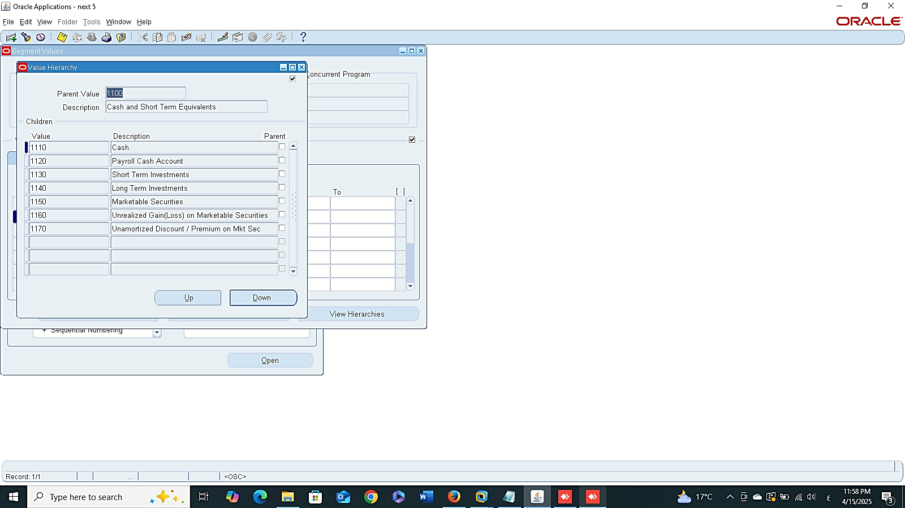
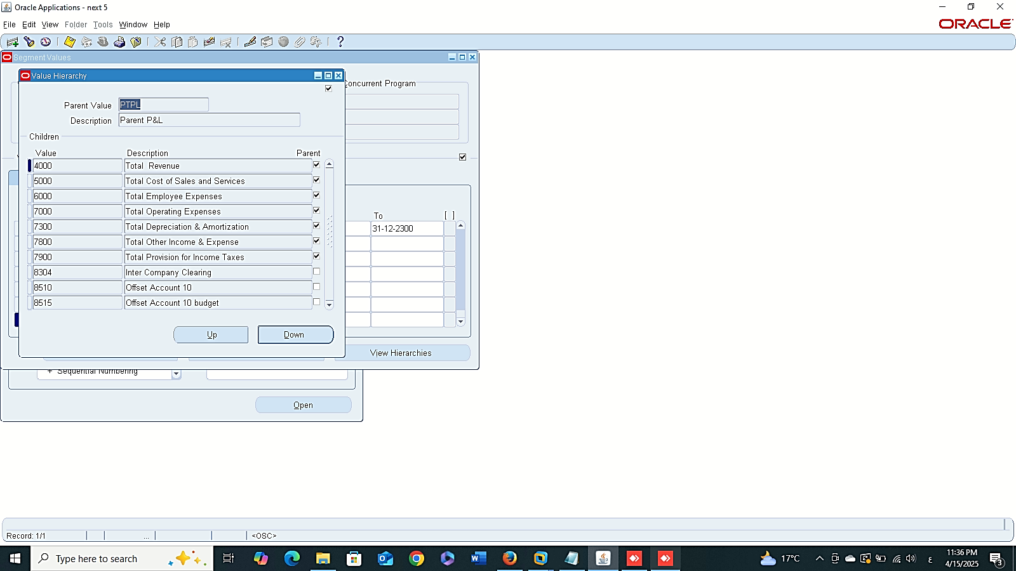
Finance Management (Payroll)
Cost :
2- Search Value
SYSTEM ADMINISTRATOR > APPLICATION > VALIDATION> VALUE

Slide 7
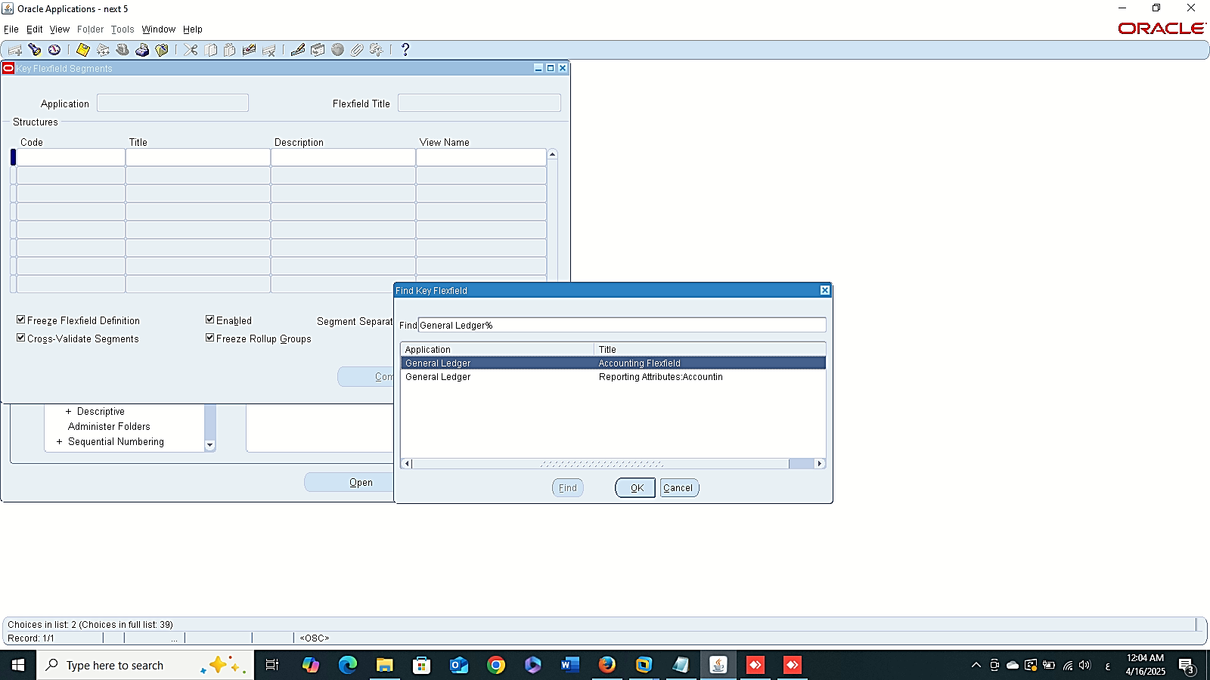
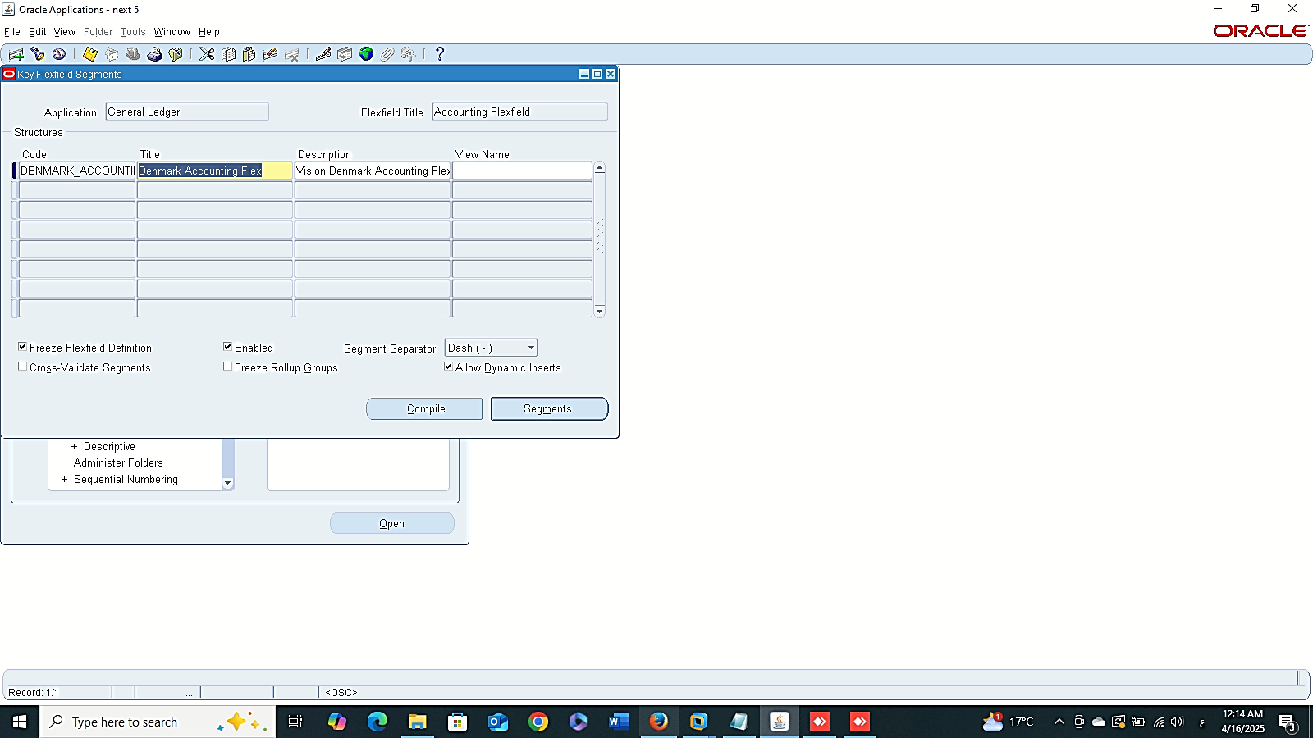
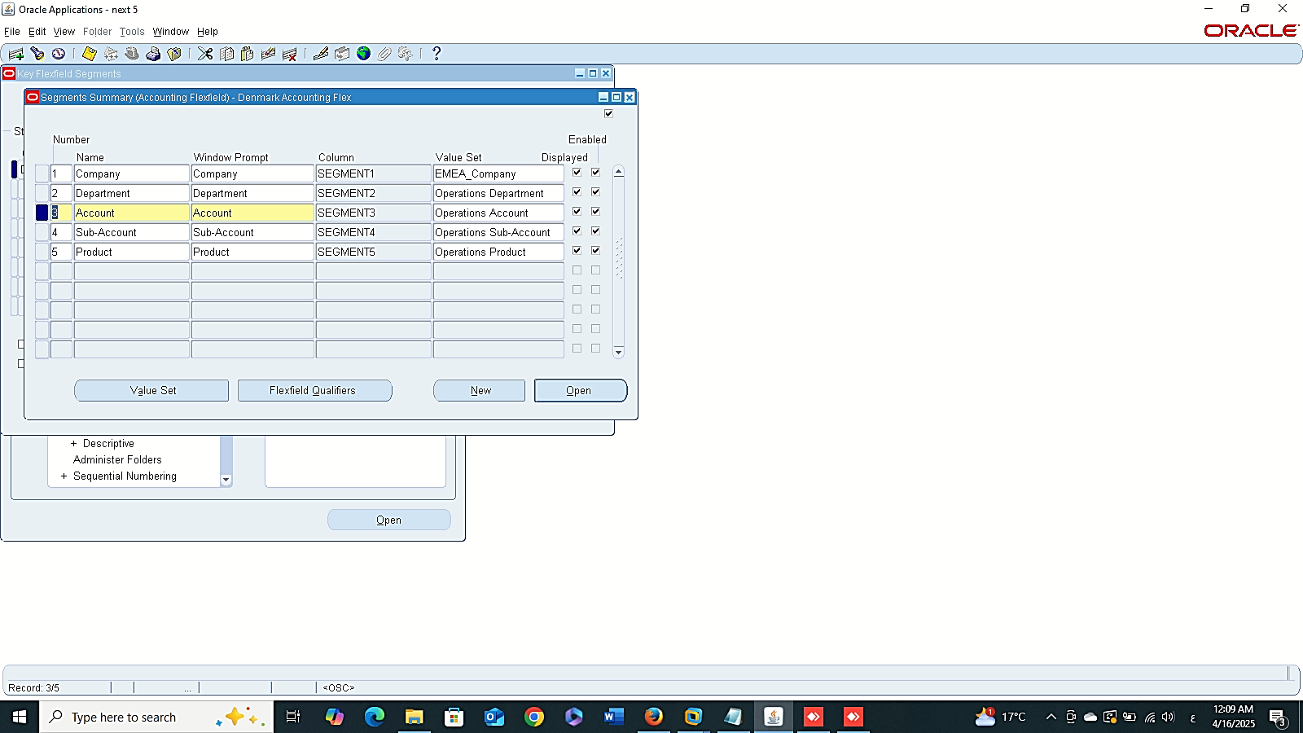
DENMARK-ACCOUNTING_FLEX
Finance Management (Payroll)
Cost :
3- Ledger Flex-field
SYSTEM ADMINISTRATOR > APPLICATION > FLEX_FIELD > KEY > SEGMENTS
Application : Ledger
Flex-field Title: Account

Slide 8
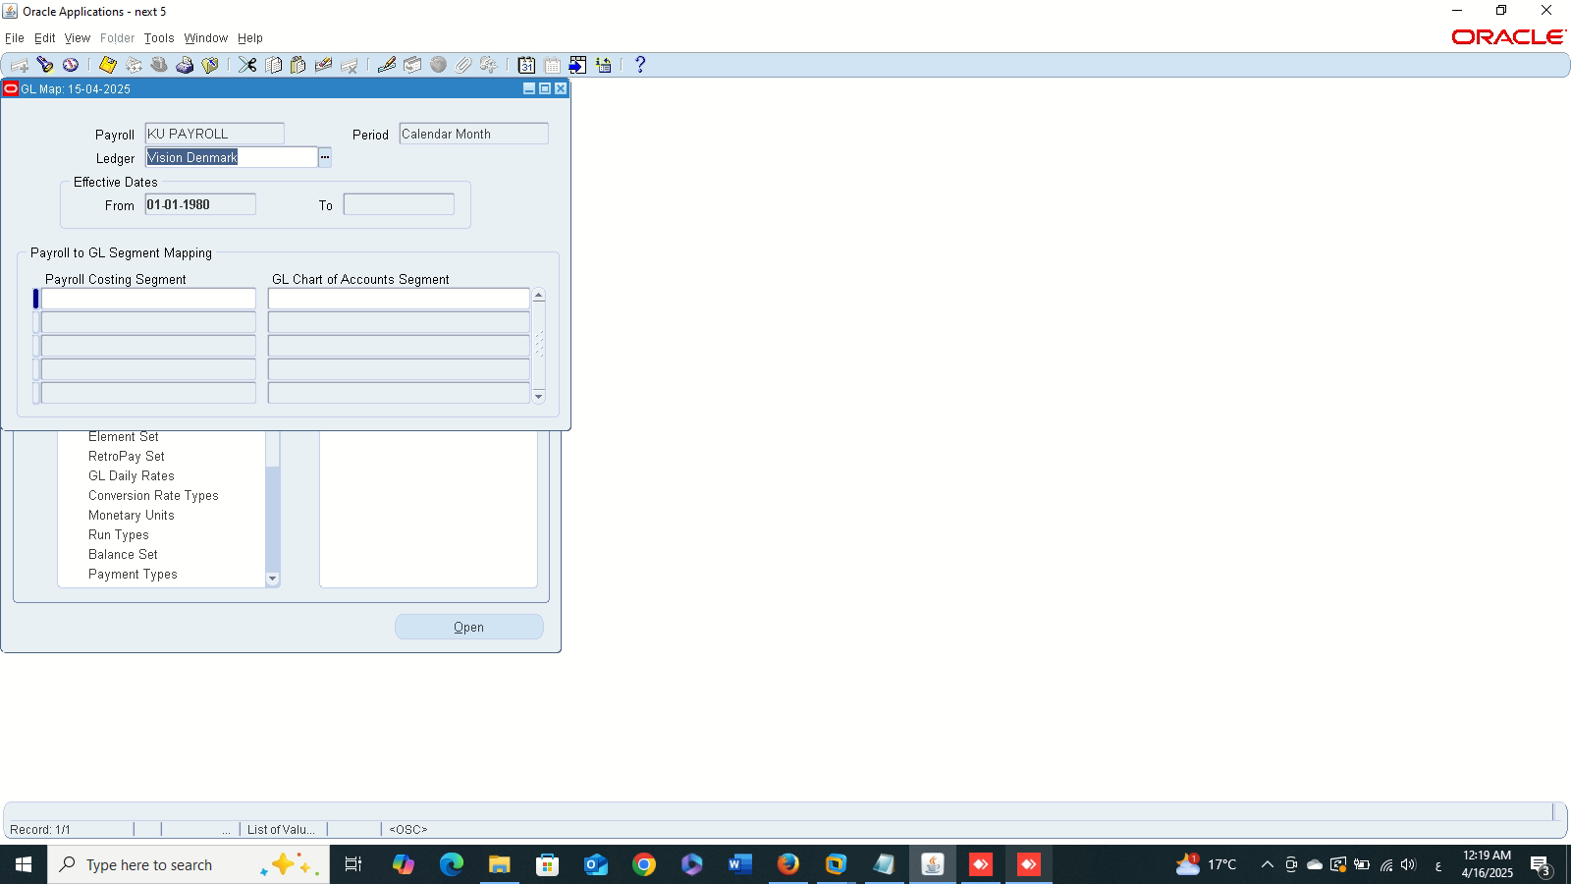
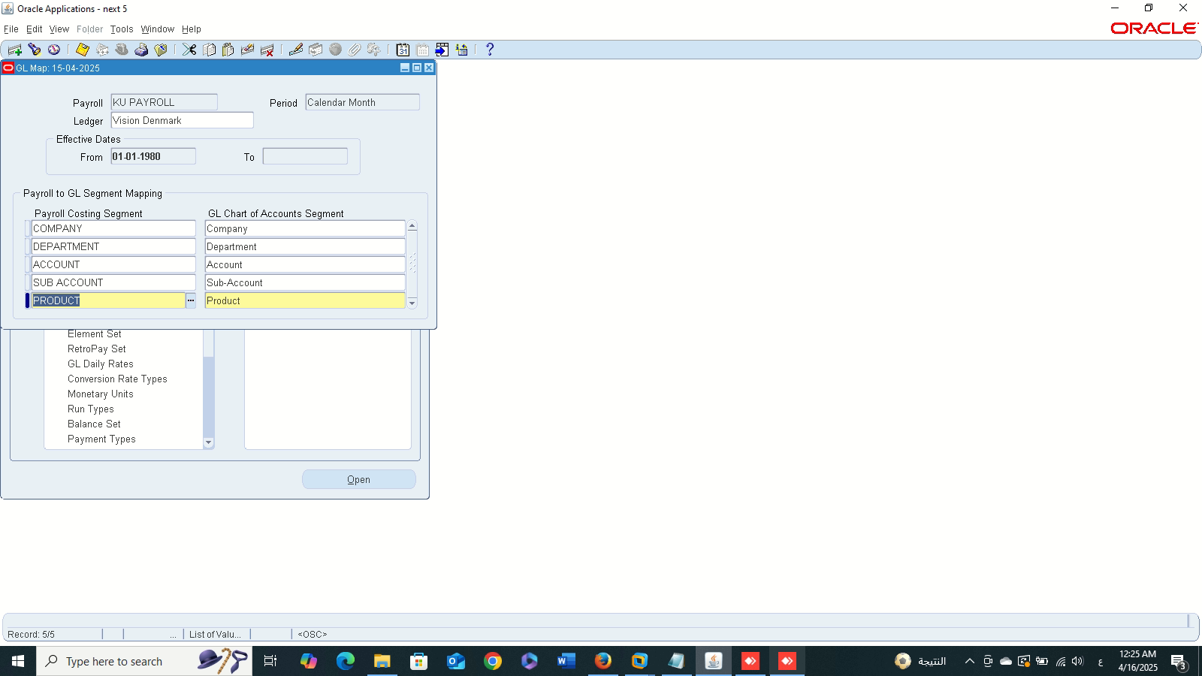
Finance Management (Payroll)
Cost :
4- GL Flex-field Map
GLOBAL HRMS MANAGER > PAYROLL > GL FLEX_FIELD MAP

Slide 9
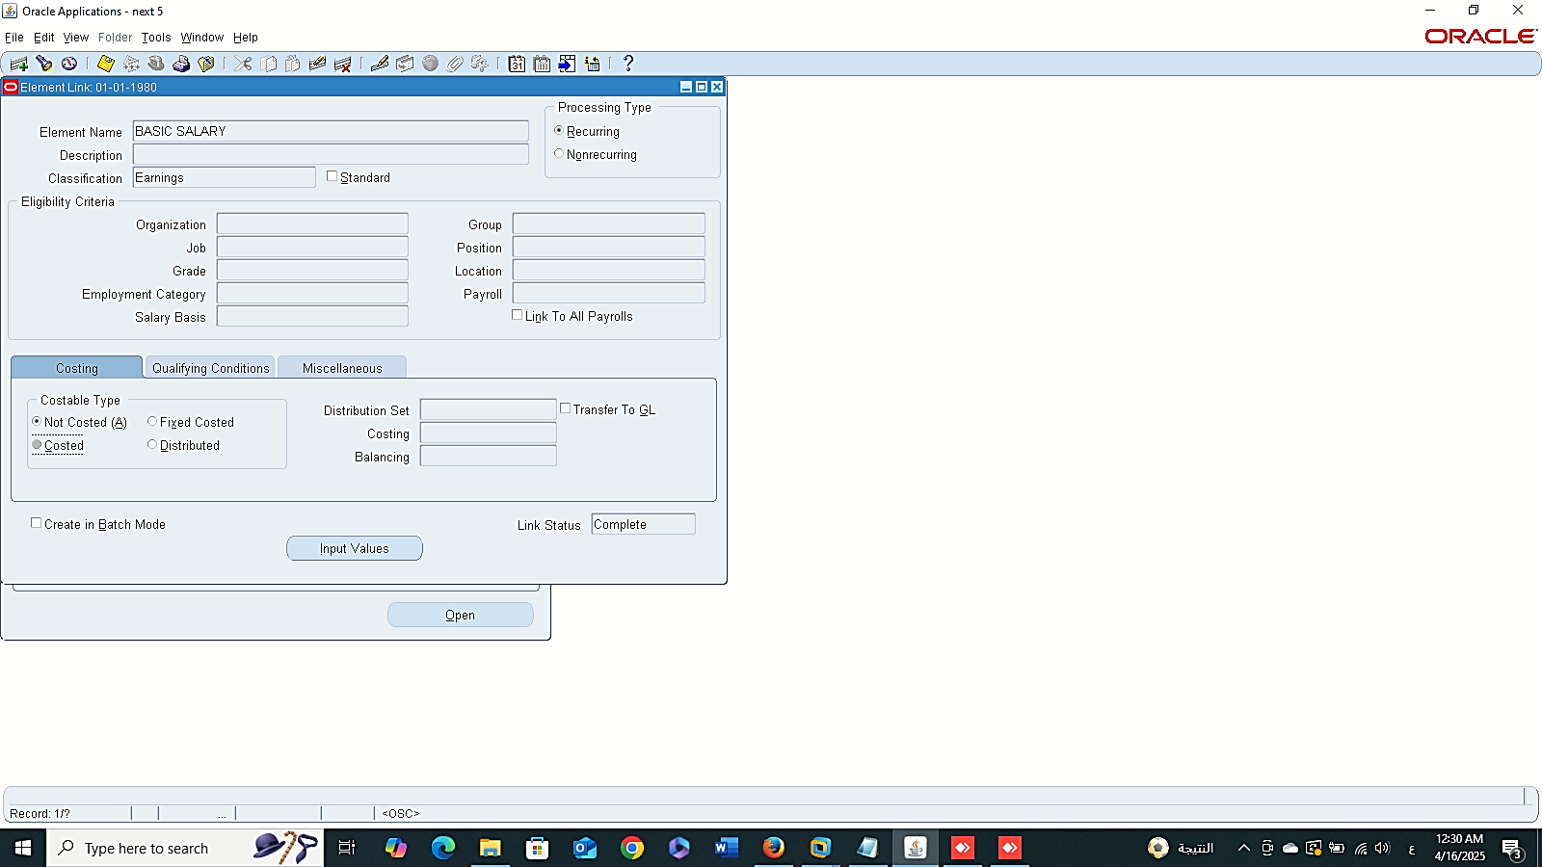
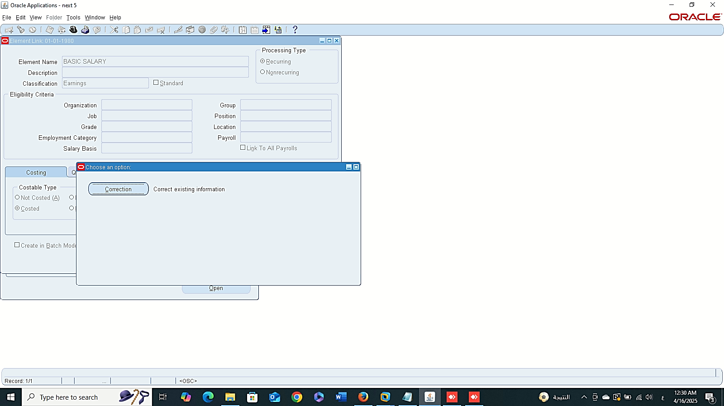
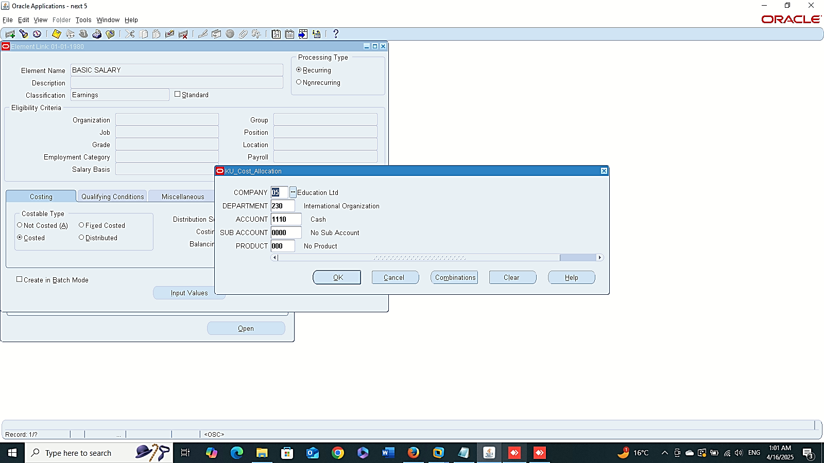
Finance Management (Payroll)
Costing:
GLOBAL HRMS MANAGER > TOTAL COMPENSATION > BASIC > LINK

Slide 10
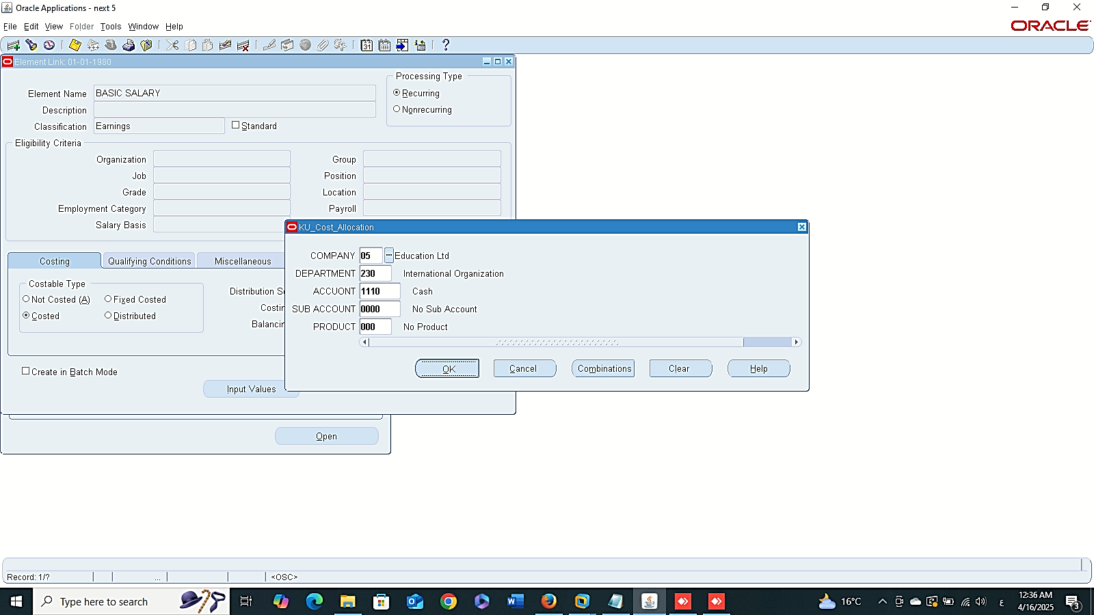
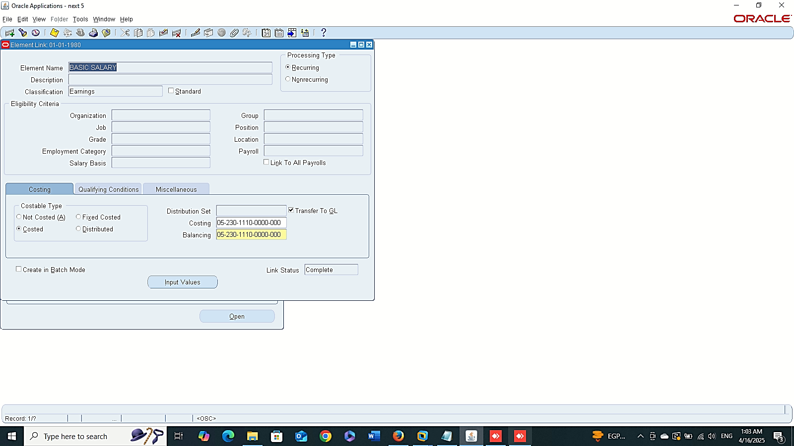
Finance Management (Payroll)
Balancing:

Slide 11
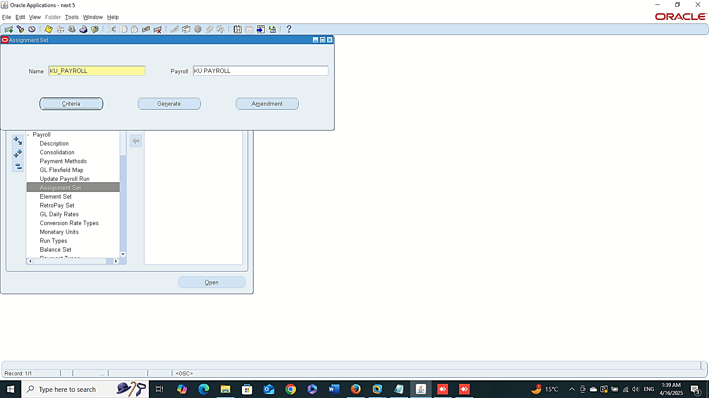
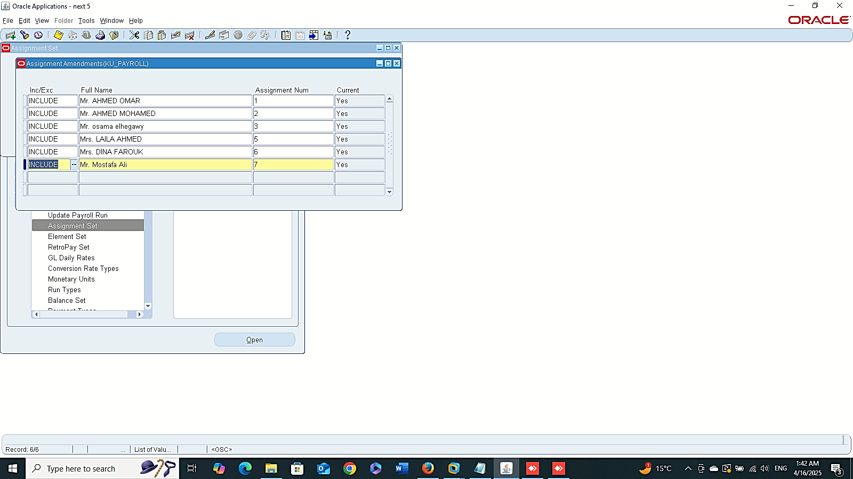
Finance Management (Payroll)
Payroll Run:
** Assignment Set:
GLOBAL HRMS MANAGER > PAYROLL > ASSIGNMENT SET

Slide 12
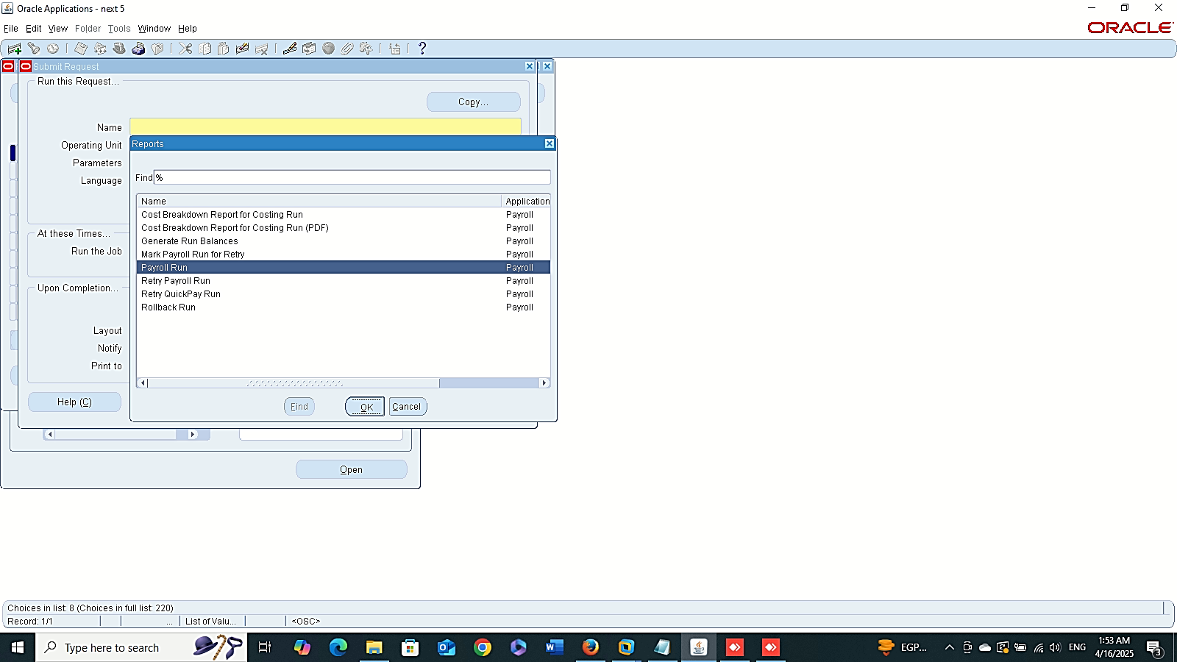
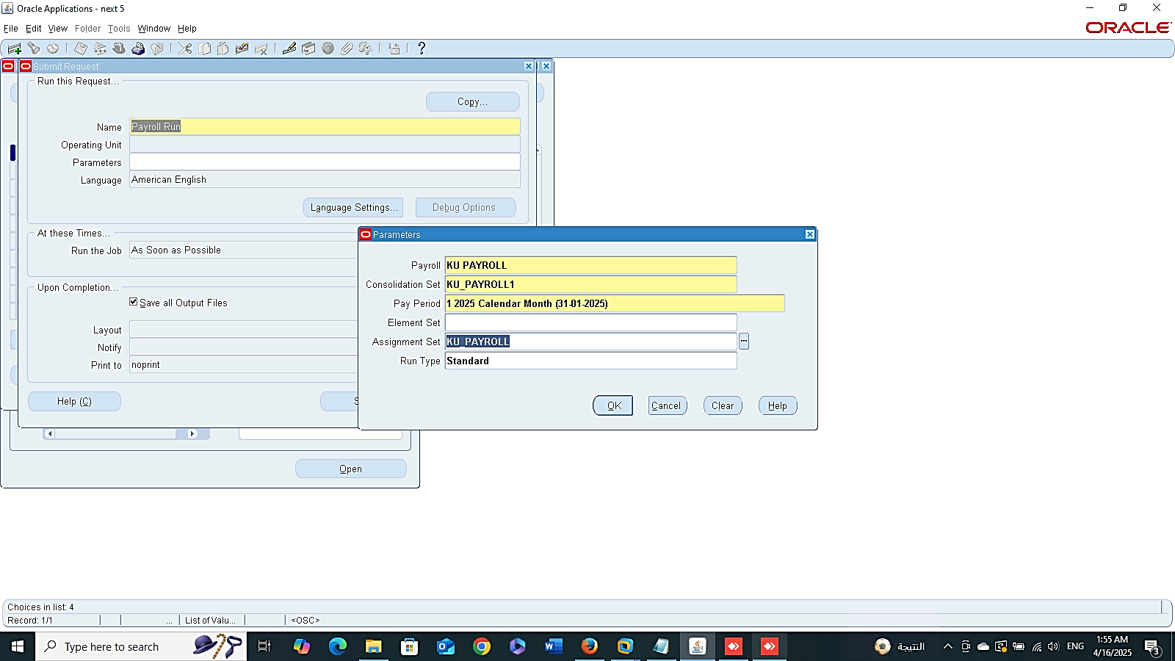
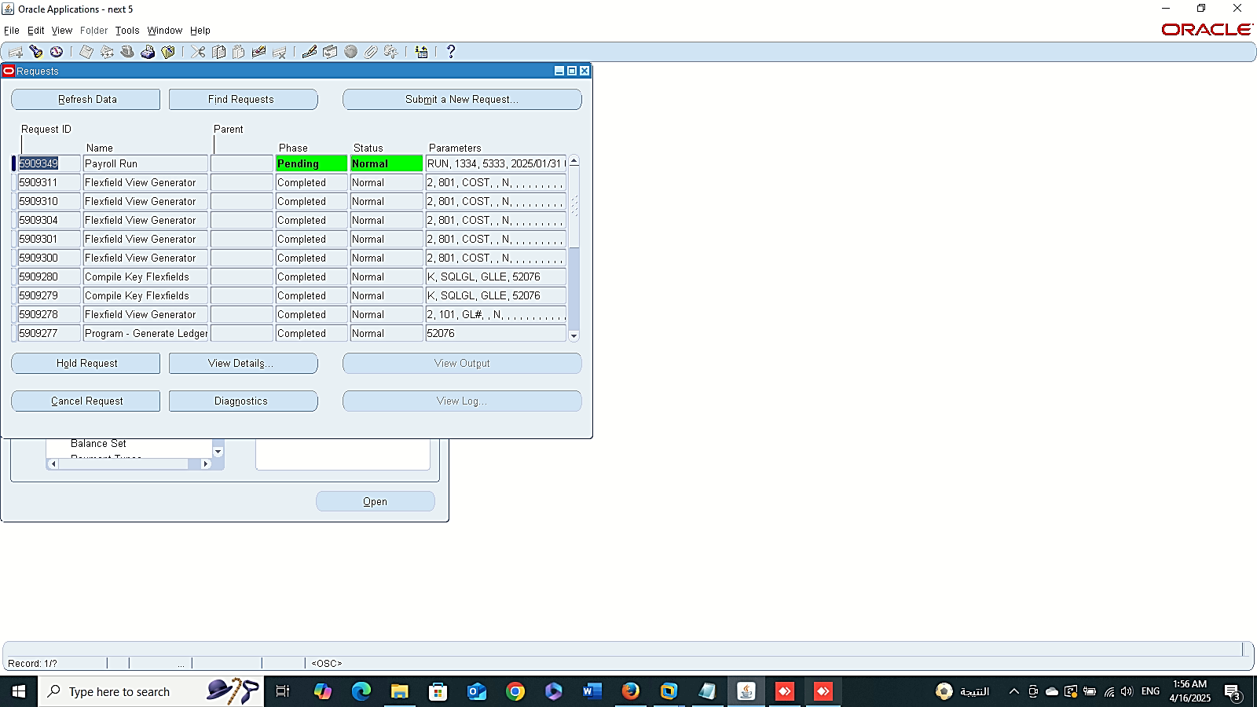
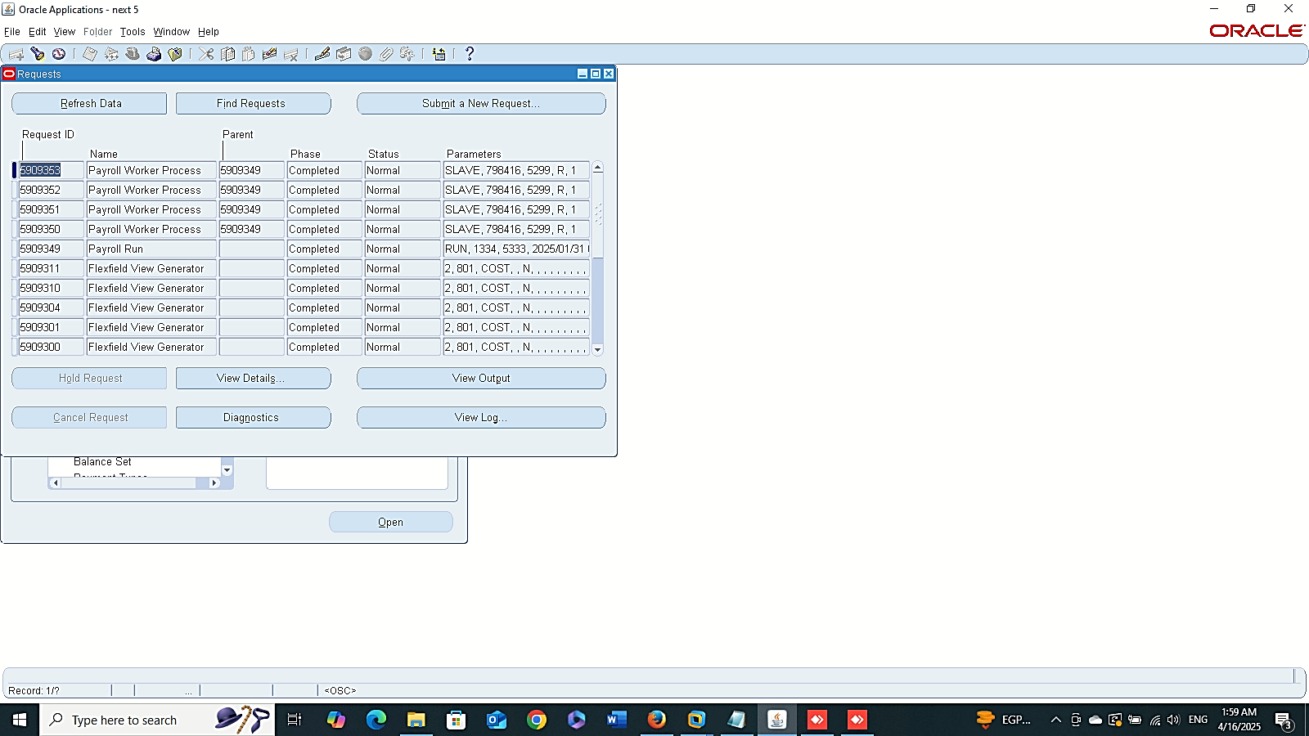
Finance Management (Payroll)
Payroll Run:
1- Payroll Run Requests :
GLOBAL HRMS MANAGER > VIEW > REQUESTS > SUBMIT A NEW REQUEST

Slide 13
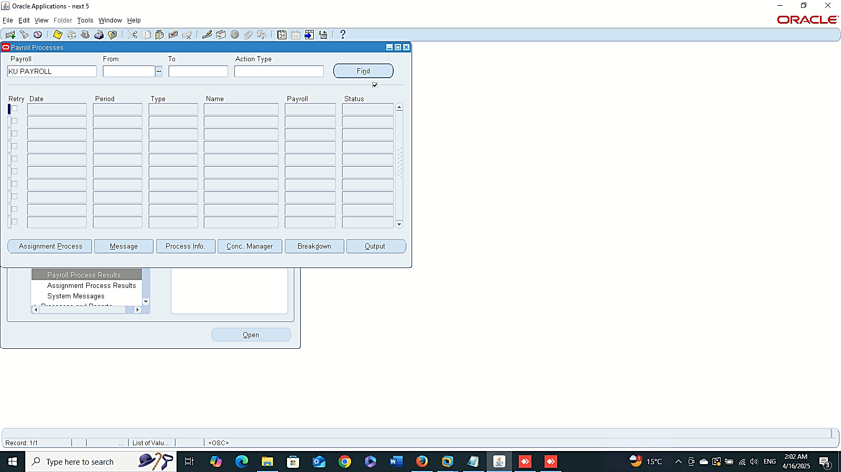


Finance Management (Payroll)
Payroll Run:
2- Payroll Process Results :
GLOBAL HRMS MANAGER > VIEW > LISTS > PAYROLL PROCESS RESULTS

Slide 14
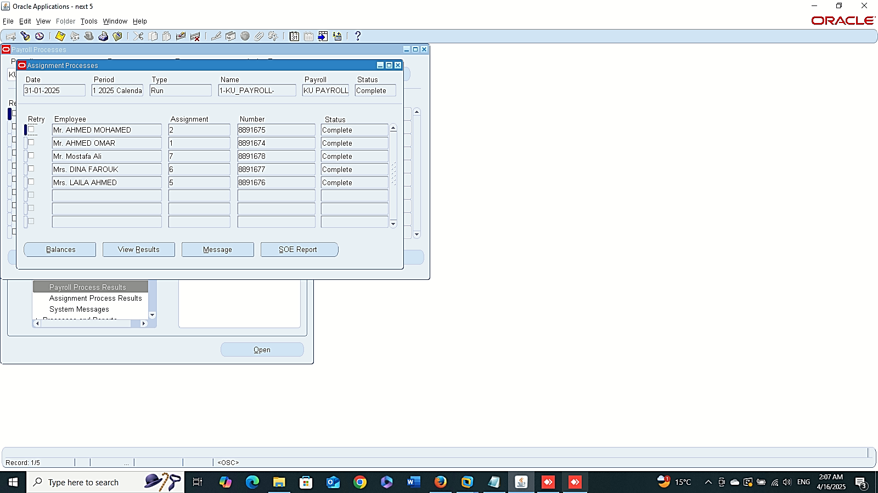
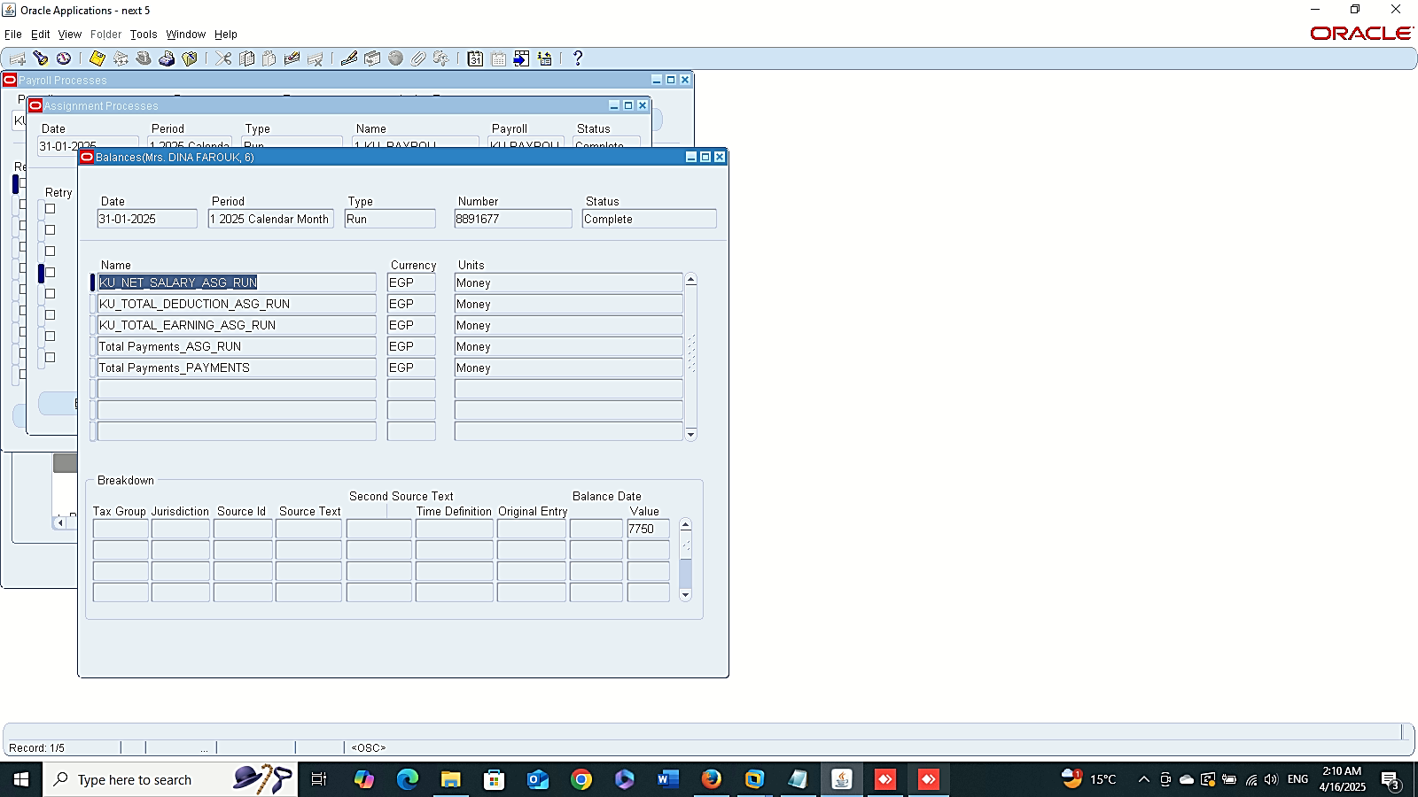
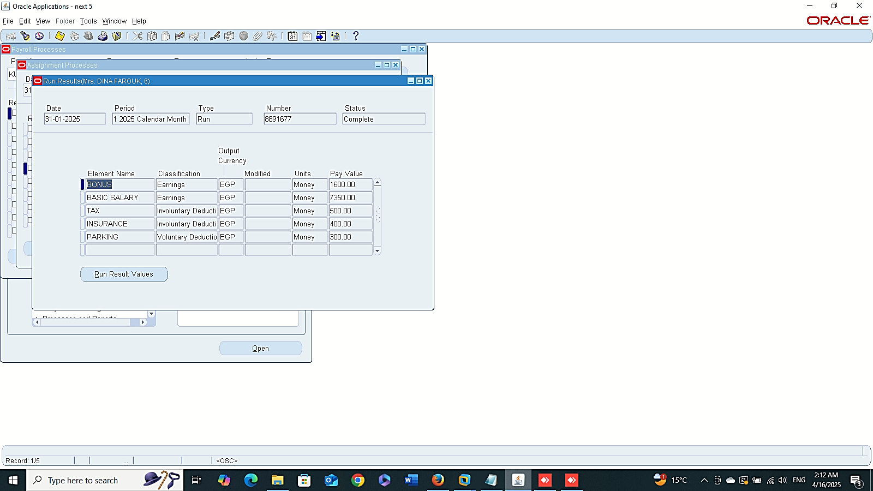
Finance Management (Payroll)
Payroll Run:
- Assignment Process
- Balance
- View Result

Slide 15
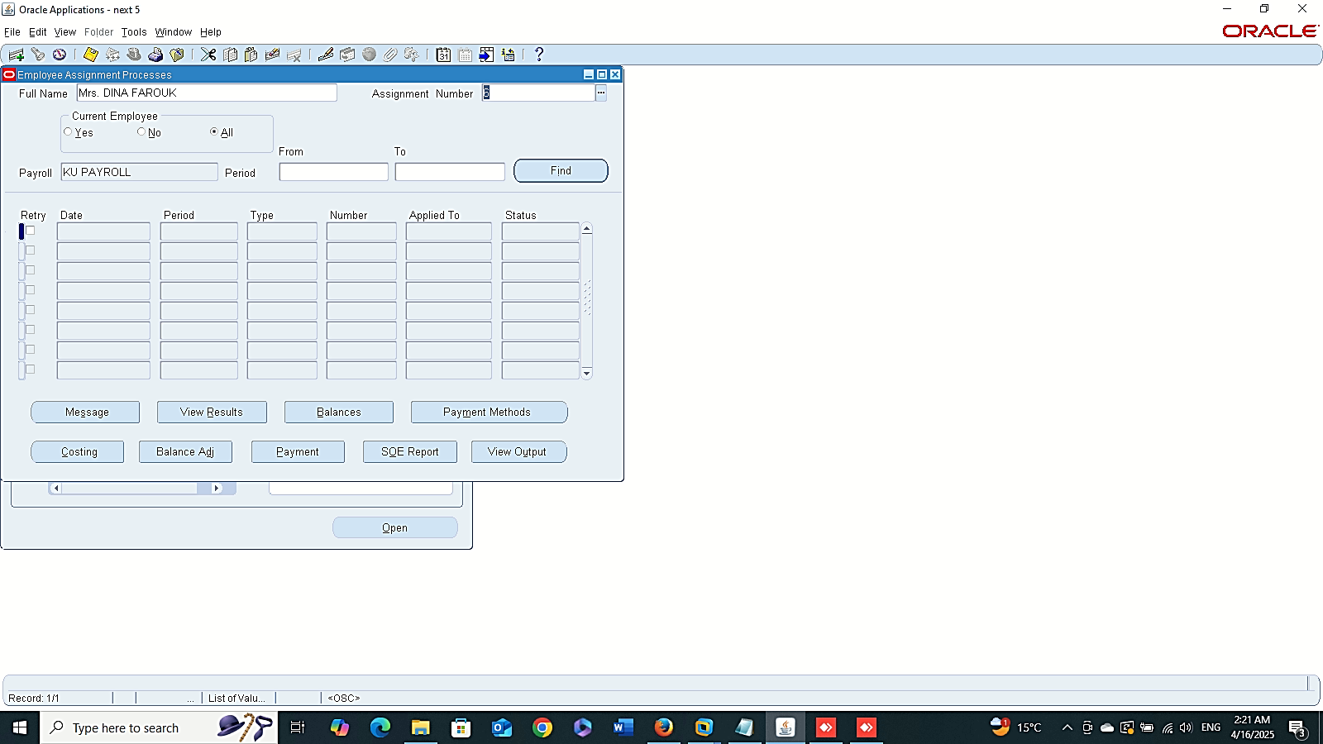
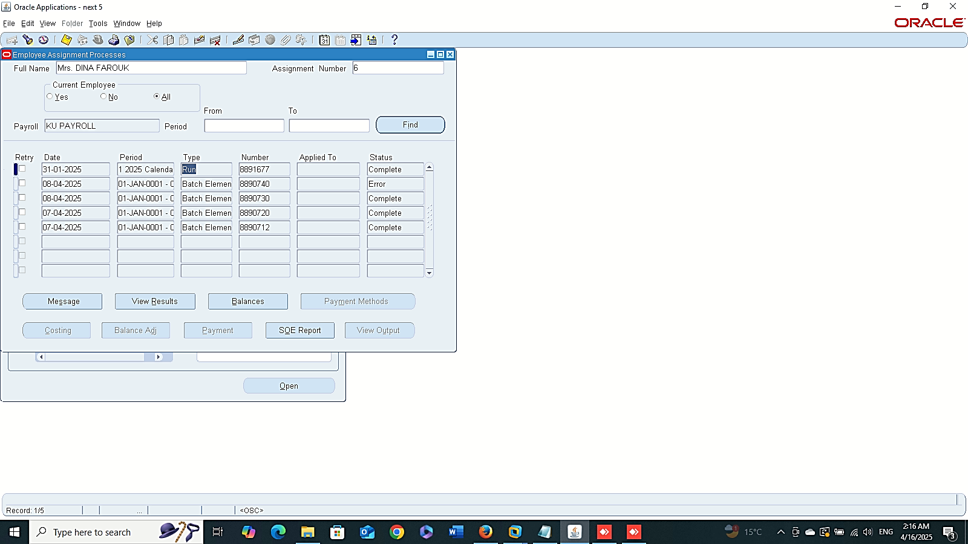
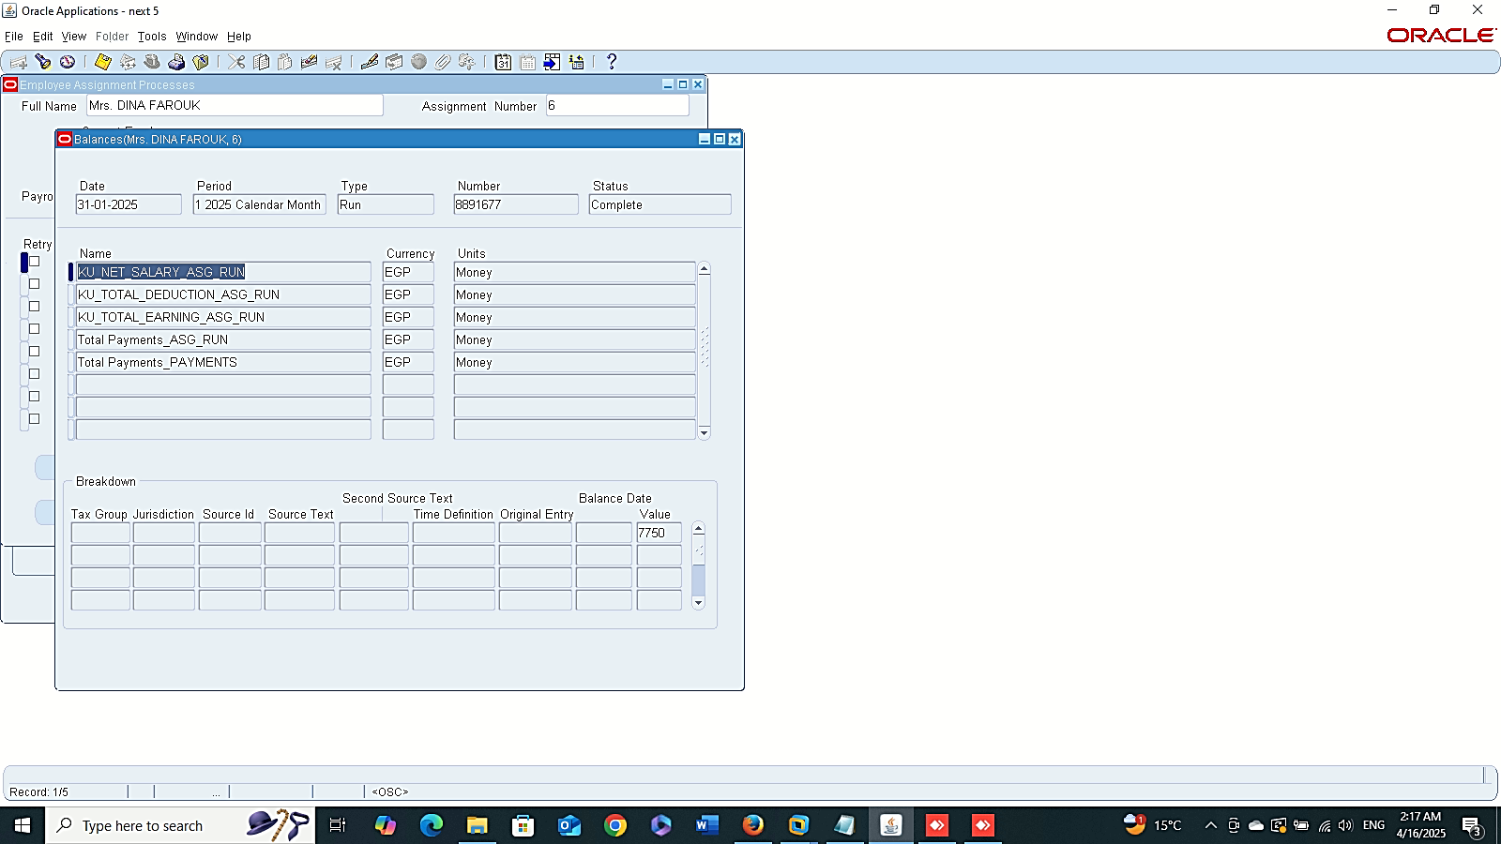
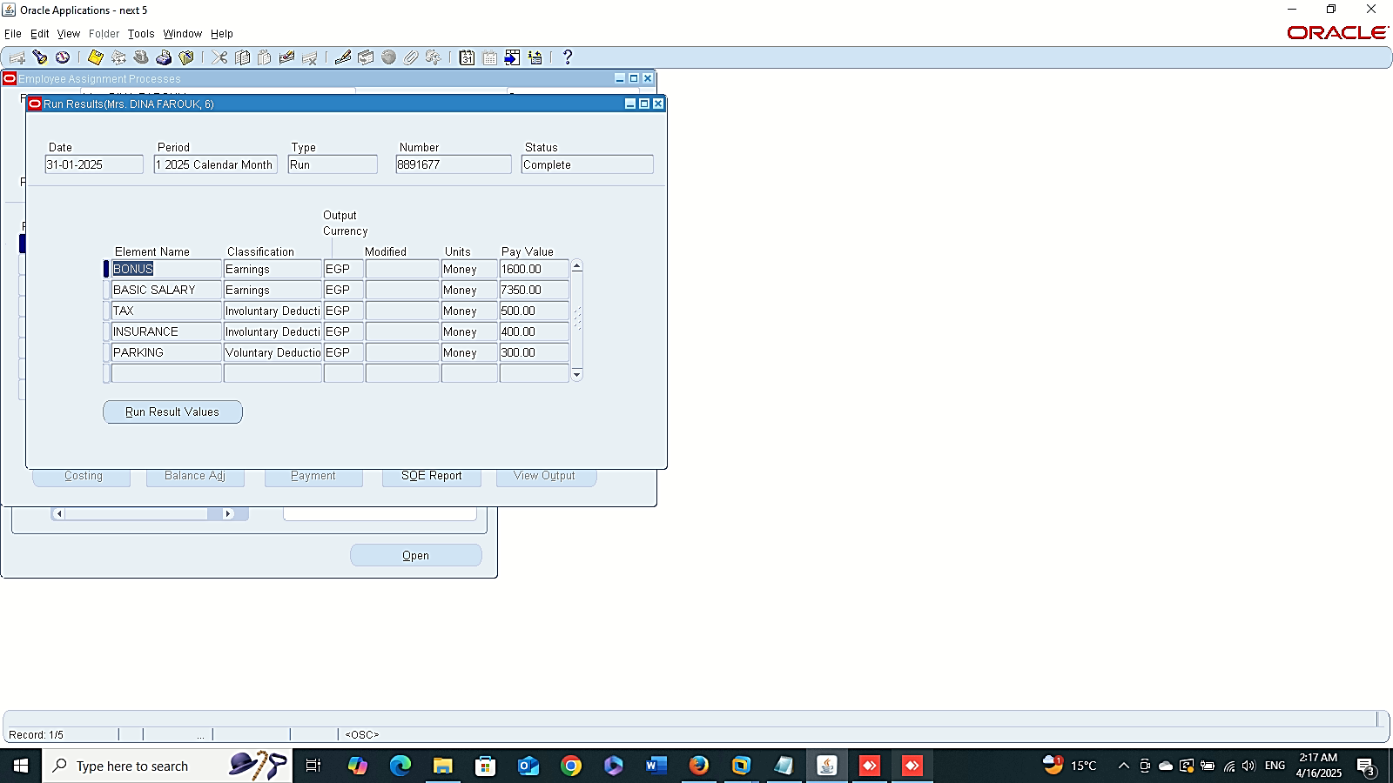
Assignment Process Result
Finance Management (Payroll)
Payroll Run:
- Assignment Process Results:
GLOBAL HRMS MANAGER > VIEW > LISTS > ASSIGNMENT PROCESS RESULTS
- Balance
- View Result
Balance
View Result

Slide 16
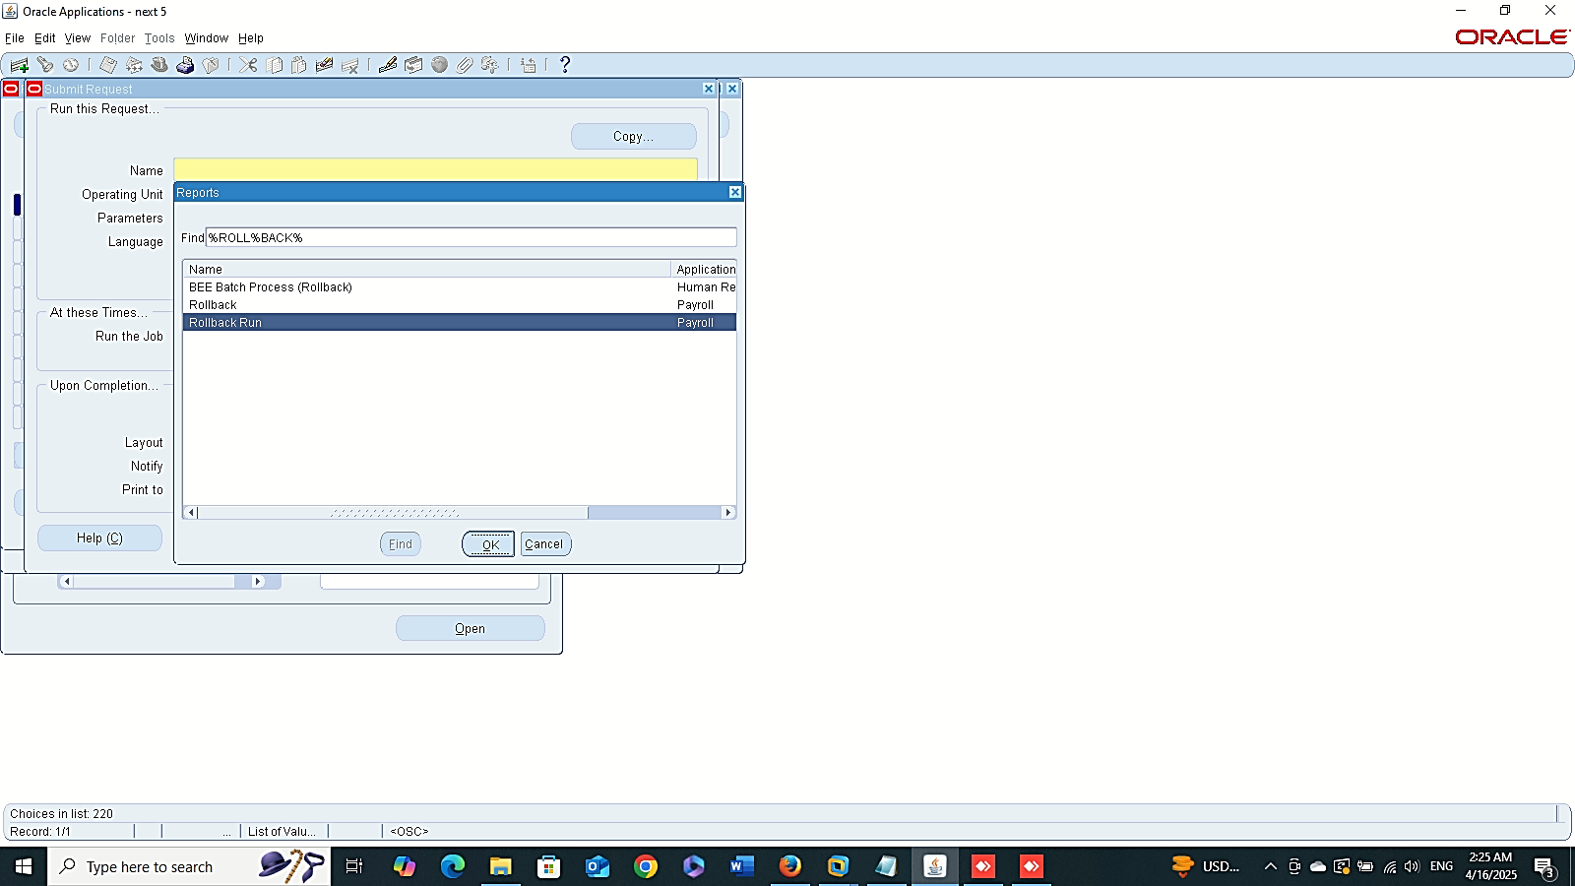
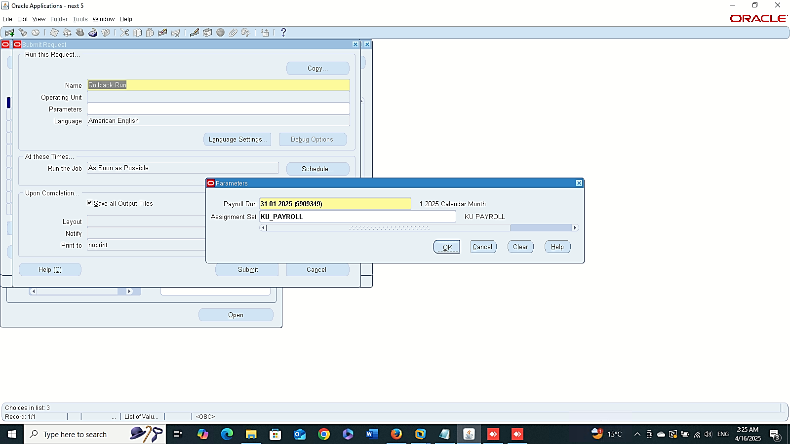
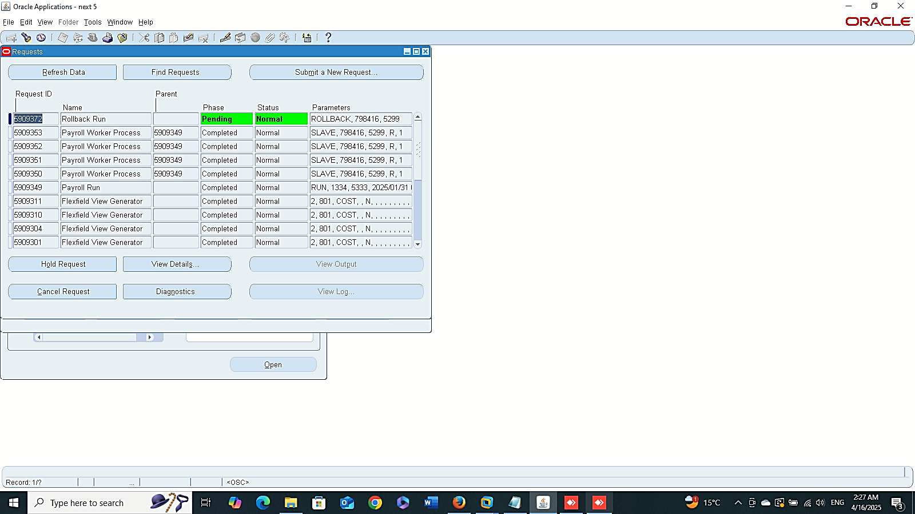

Finance Management (Payroll)
Payroll Run Roll Back:
GLOBAL HRMS MANAGER > VIEW > REQUESTS > SUBMIT A NEW REQUEST > ROLLBACK RUN

Slide 17
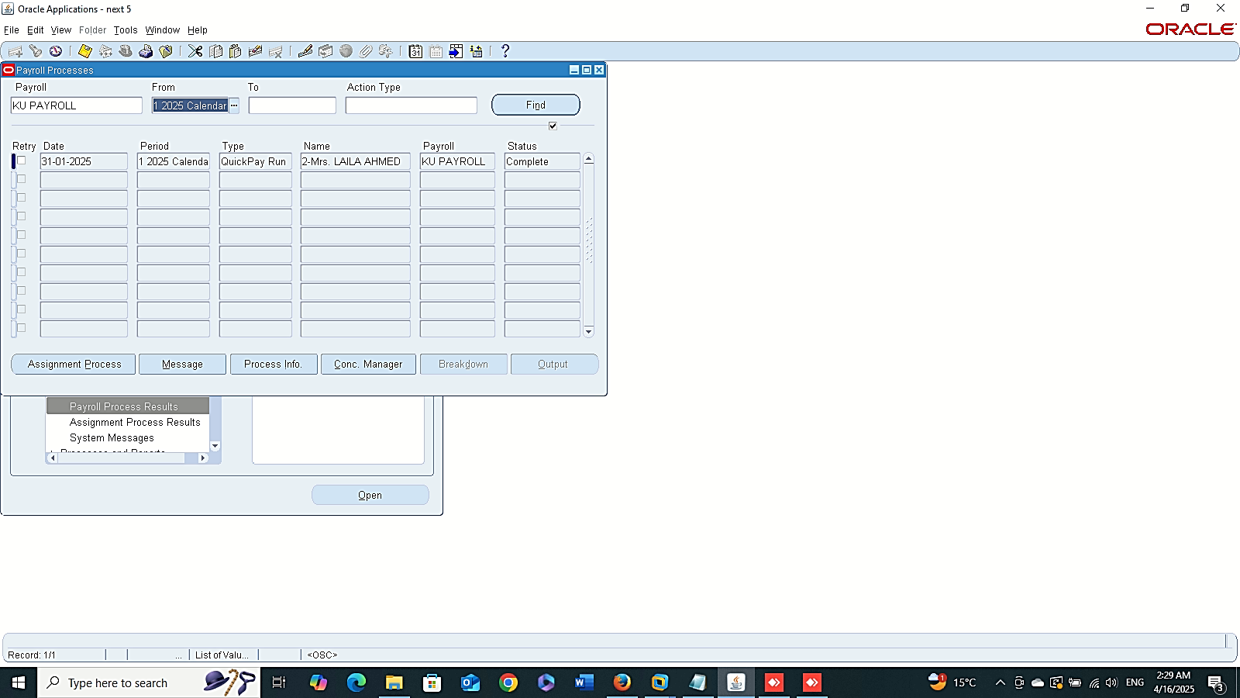
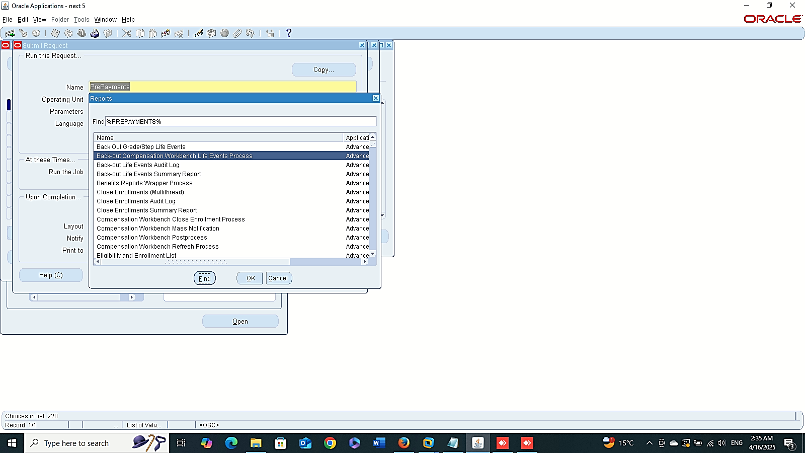



Process Results
Prepayment Requests
Finance Management (Payroll)
Payroll Process Results:
GLOBAL HRMS MANAGER > VIEW > LISTS > PAYROLL PROCESS RESULTS
Prepayment Requests
Global HRMS MANAGER > VIEW > REQUESTS > SUBMIT A NEW REQUIST > PREPAYMENTS

Slide 18



Prepayment Requestsv
Finance Management (Payroll)
Payroll Process Results:
- Prepayment Requests
Global HRMS MANAGER > VIEW > REQUESTS > SUBMIT A NEW REQUIST > PREPAYMENTS
Payment Method

Slide 19





Finance Management (Payroll)
Payroll Process Results:
- Prepayment Roll Back
Global HRMS MANAGER > VIEW > REQUESTS > SUBMIT A NEW REQUIST > ROLLBACK

